Slide 1
Melwood Site Plan Application
750 23rd Street S, Arlington
Meeting with JD Spain
1/30/2025

Slide 2
Agenda
Introductions
Neighborhood Overview
Proposed Melwood Upzoning Overview
Questions
Follow up

Slide 3
Our Neighborhood

Slide 4
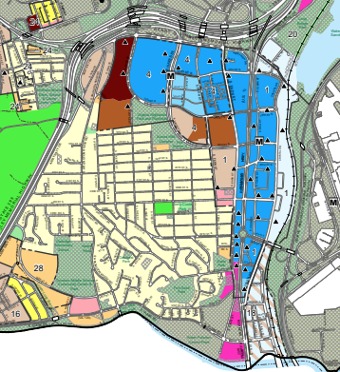
Aurora Highlands - Home to
Amazon HQ2 / National Landing
Arlington Water Treatment Facility (adj)
Recycling Facility
Costco
Bus Depot / Pent City Metro
Fashion Center
23rd Street Restaurant Row
Multiple Car Rentals
Pentagon City Bus Transfer
Millions of Tourists
~5 daycares
3 Churches
Claridge House – senior affordable housing for 300+
Crystal House – affordable housing ~1500+
3 public parks: Virginia Highlands, Nelly Custis, Eads
All packed into ~½ square mile
FASHION
CENTER
HOFFMAN
BOSTON
HQ 2
COSTCO
RIVER
HOUSE
ARMY
NAVY
VA HIGHLANDS
CLARIDGE HOUSE
CRYSTAL
HOUSE
23rd ST
CC2DCA
BUS
GUNSTON /
OAKRIDGE
GIANT
WATER TREATMENT
APEX

Slide 5
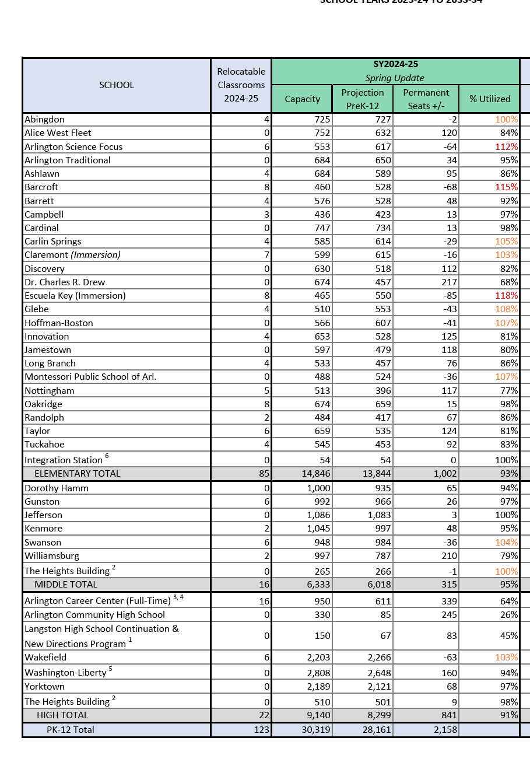
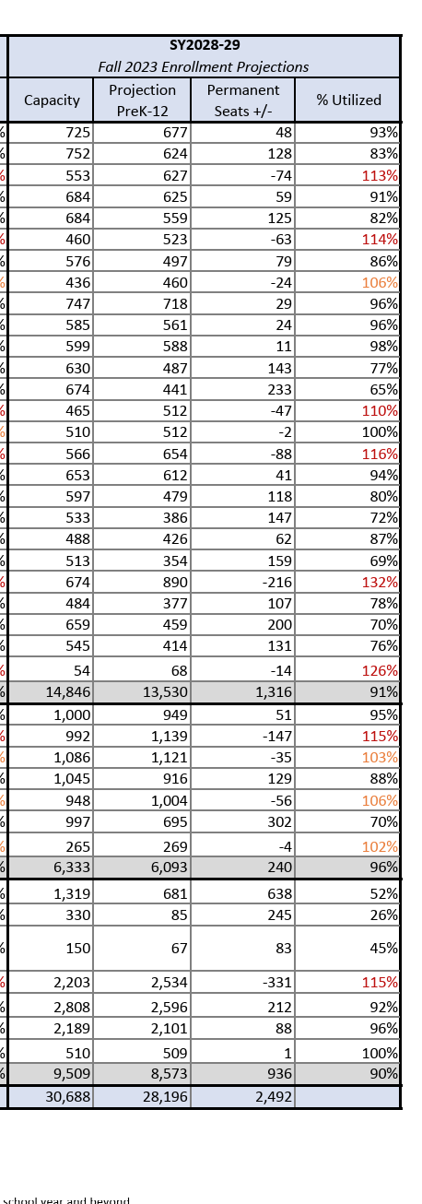
we’re gonna be (more) Popular!
Population has doubled since 2000 &
growth is not stopping
2024
Oakridge
96% capacity including 8 trailers
Gunston
97% capacity including 6 trailers
Wakefield
103% capacity including 6 trailers
2028
Oakridge
132% over including 8 trailers –
216 PERMANENT SEATS OVER AFTER INCLUDING TRAILERS
Gunston
115% over including 6 trailers
147 PERM SEATS OVER AFTER TRAILERS
Wakefield
115% including 6 trailers
331 PERM SEATS OVER AFTER TRAILERS

Slide 6
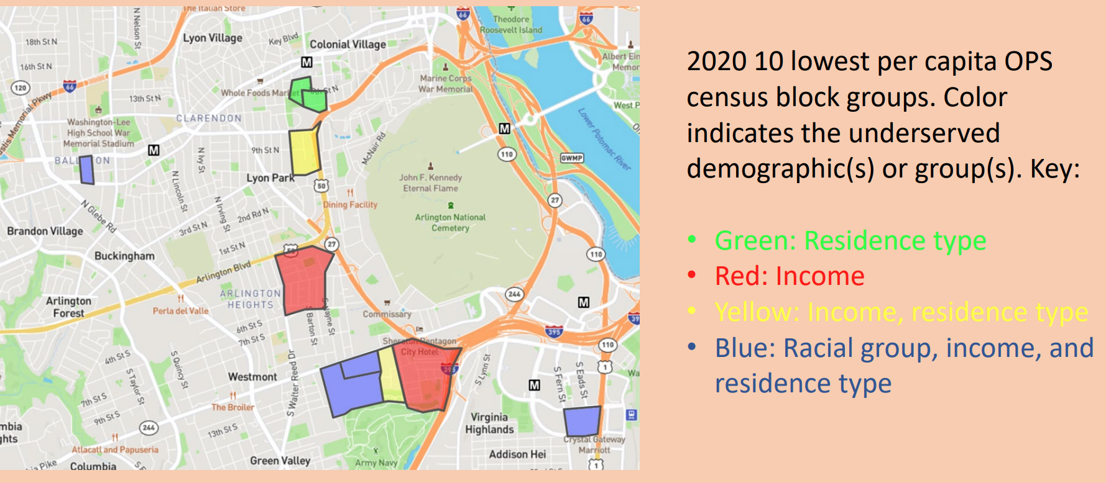
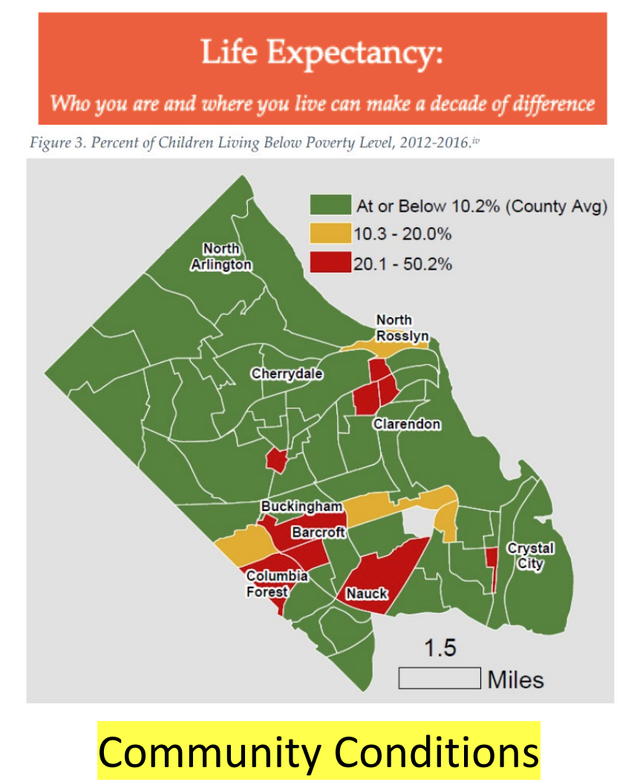
Community Services, Open Space & Health Equity in Arlington
Open Space Lost or Gained at 750 23rd Street is critical – Nelly Custis Park is blocks from one of the lowest open space demographics in the County by all 3 measures – racial group, income and residence type. Residents of nearby hi-rise apartments use tiny Nelly Custis Park heavily.
The site is also adjacent to one of the areas of highest child poverty in the county – and this was in 2016 before 1300+ units of affordable housing at Crystal House. Community services like open space, schools, community center and a library are critically needed, and this location is uniquely suited to providing them. South Arlington has far more affordable housing than North Arlington – adding more is not in keeping with the Affordable Housing Masterplan which calls for distributing affordable housing equitably across the county.
What we need is community and open space to prevent health inequity as stated by Livability22202 “Because of the extraordinary successes in delivering affordable housing units of all kinds the last few years, the community feels it is time to prioritize infrastructure needs for current and future residents. The community has an ongoing interest in helping existing and future residents remain in the neighborhood.”
Site
https://www.civfed.org/newContent/2024-04/2024-04%20ACCF%20Public%20Space%20Equity%20Presentation.pdf
March 2024 CivFed Presentation on Open Space Equity in Arlington
Aurora
Highlands
Site
https://www.civfed.org/newContent/2024-04/2024-04%20ACCF%20Varghese%20Presentation.pdf
March 2024 Civ Fed Presentation on Poverty in Arlington

Slide 7
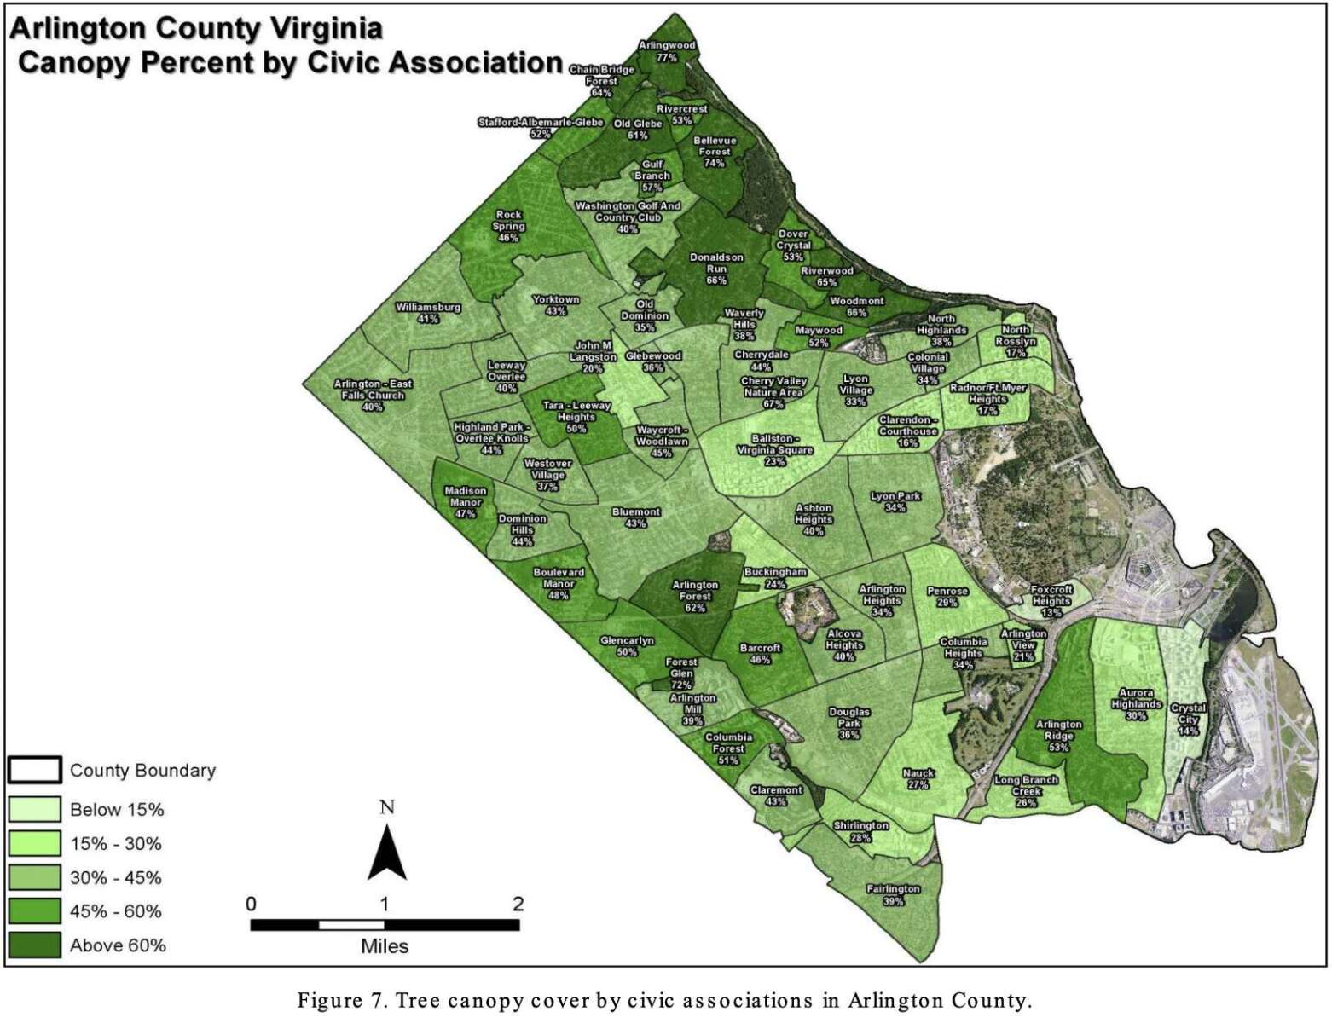
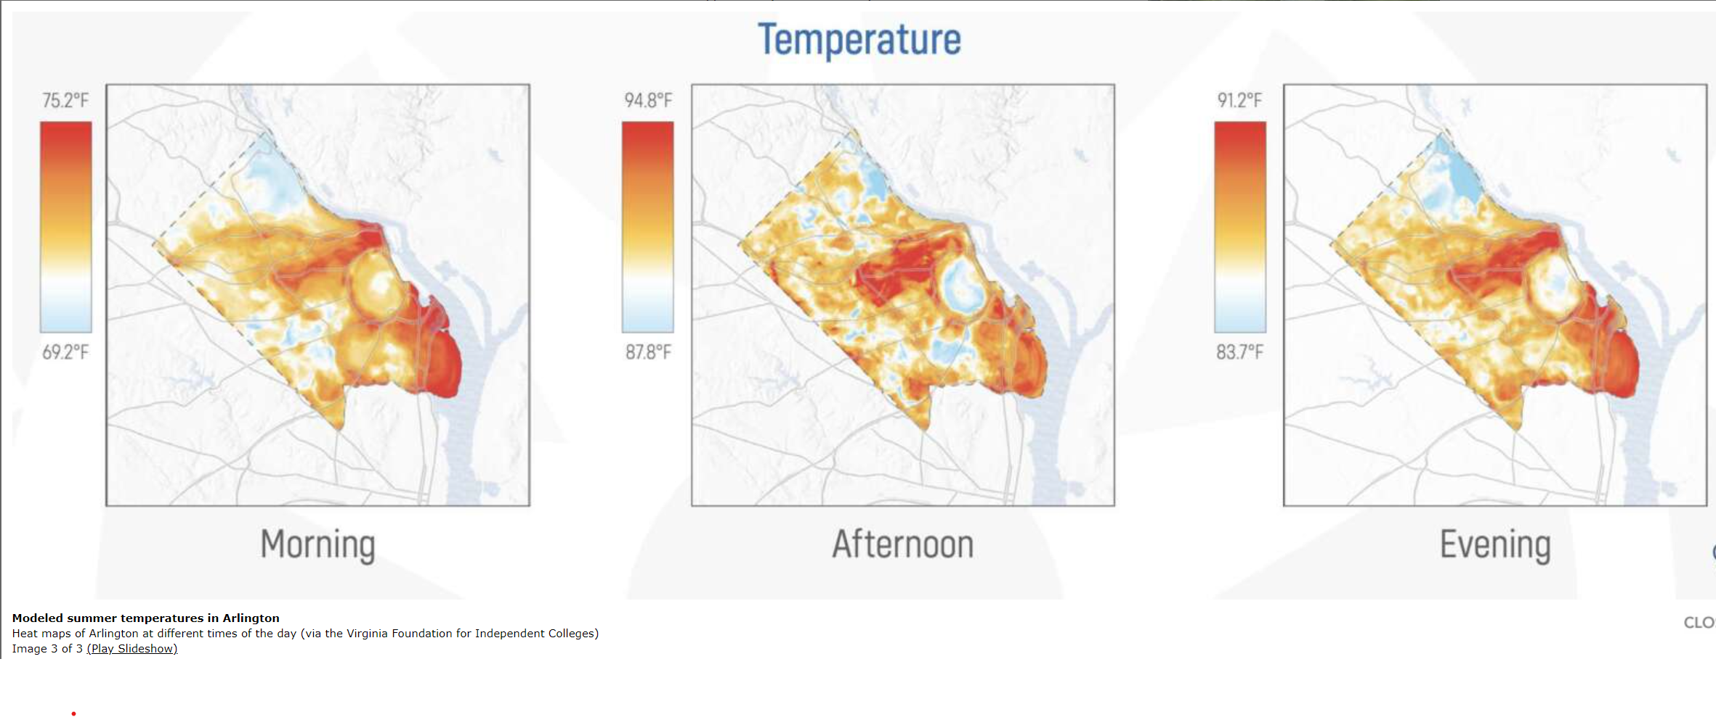
Tree Canopy Inequity In Arlington & Heat Island Effect
Arlington needs to honor its commitment to being a partner in the Biophillic Cities Network as Libby Garvey stated back in 2020 “Now is the time to develop better systems and practices so that future generations of Arlingtonians benefit…people are happier, healthier and more productive when they live close to nature. See link:
https://www.arlnow.com/2020/03/12/arlington-joins-group-dedicated-to-connecting-cities-and-nature
Tree Inequity is - not surprisingly - highest in areas of Open Space Inequity and poverty.
The Council of Governments is calling for urban tree coverage at 35 – 40% and Aurora Highlands is currently at 30% - via math that means Aurora Highlands needs about 25% MORE TREES to get to average (30% x 1.25 = 38%.) There are few opportunities for more trees given the amount of development in the neighborhood both on commercial and single-family sites and this site represents a unique opportunity to increase canopy coverage – if the development is done with care.
Lack of tree coverage is also a hyper local issue with the heat island affect the worst in areas with fewer trees. Aurora Highlands is typically 6 to 8 degrees warmer than the more leafy parts of the county in the summer which is a serious health issue.
https://www.arlnow.com/2022/03/31/arlingtons-hottest-areas-lack-tree-canopy-to-soak-up-the-sun-study-finds/
https://www.arlnow.com/2024/04/24/new-tree-canopy-goal-for-d-c-area-calls-on-arlington-to-get-greener

Slide 8
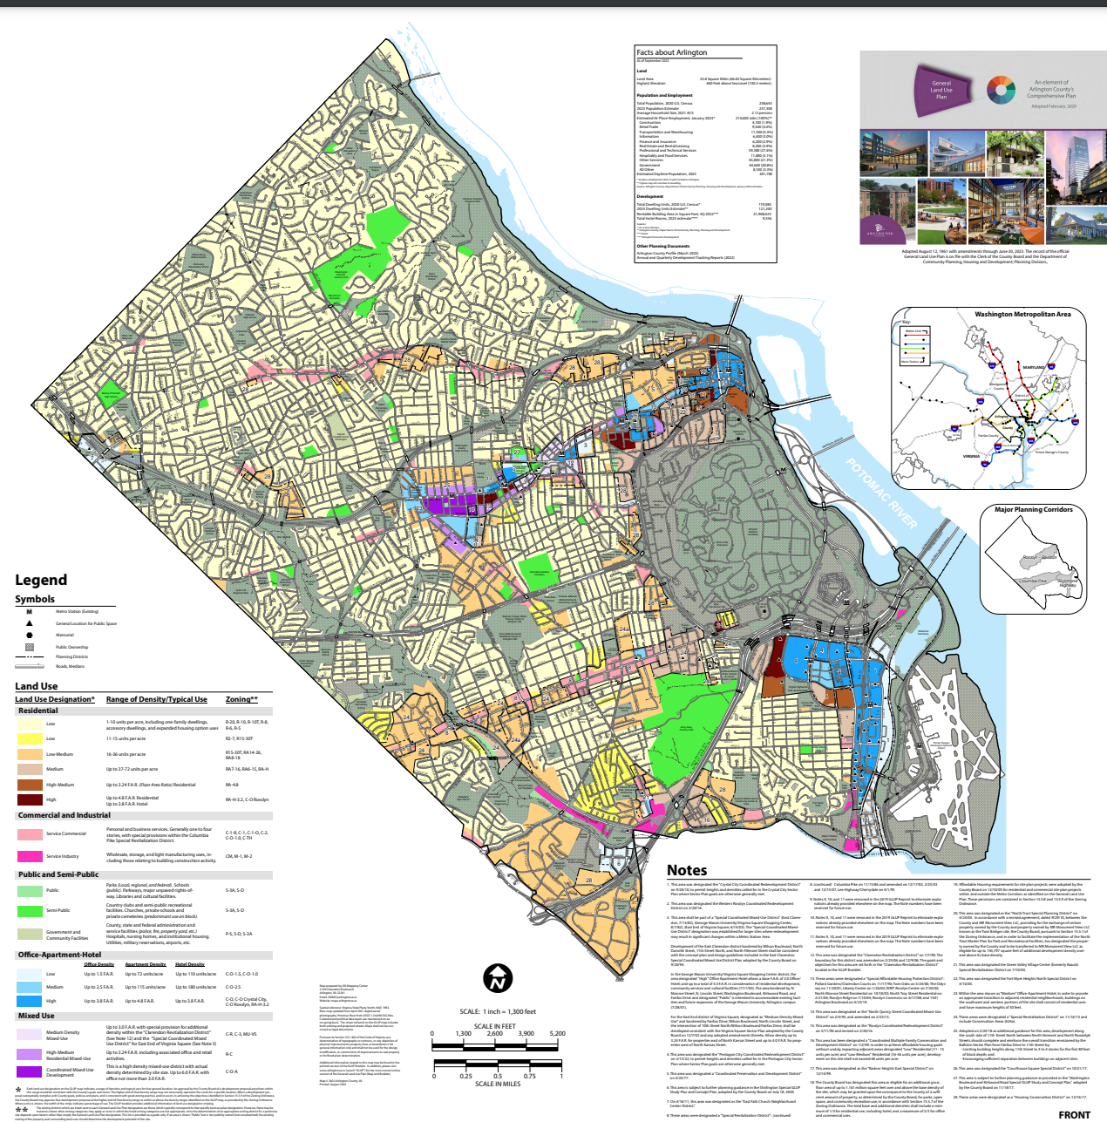
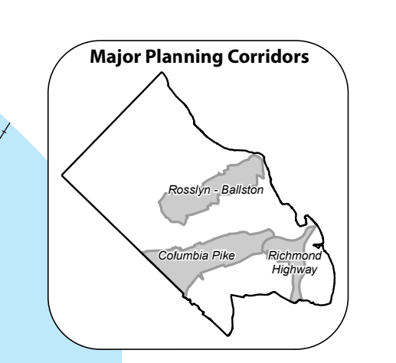
The General Land Use Plan (GLUP) – Planning corridor overlay approximated – see inset upper right.

Slide 9
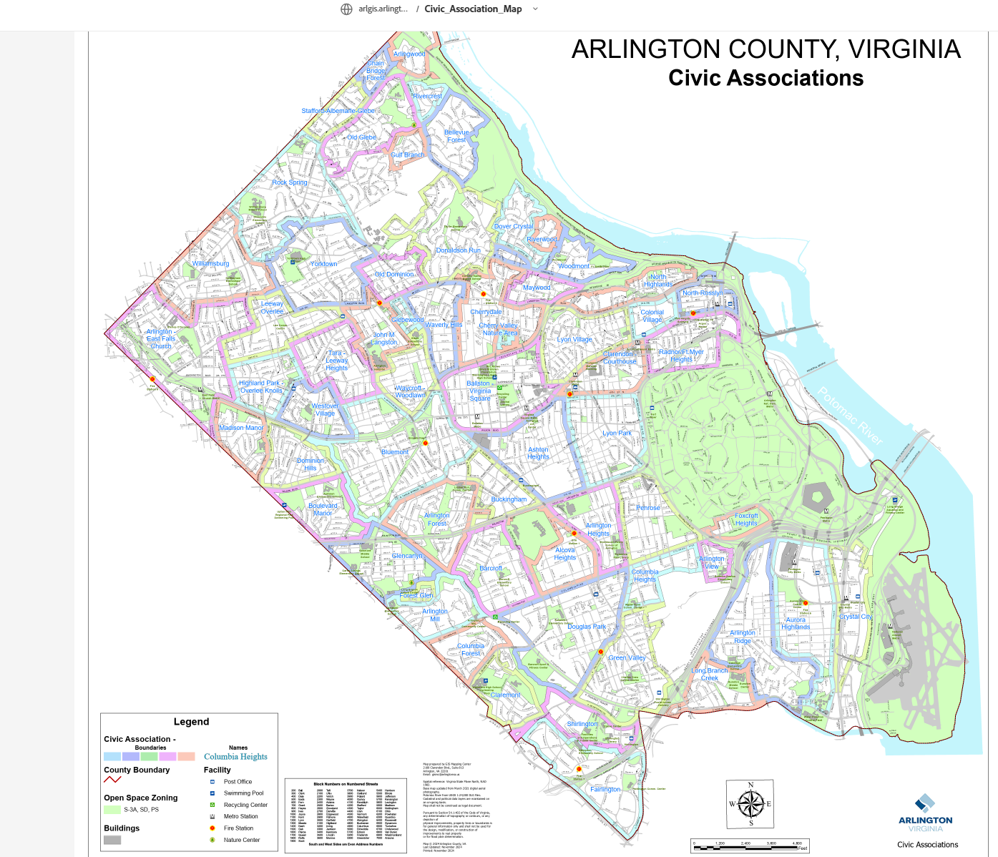
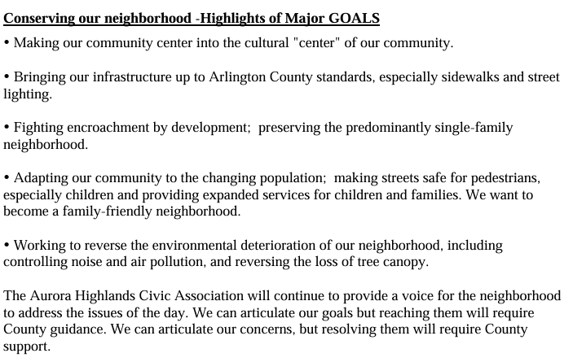
2008 AURORA HIGHLANDS NC PLAN
NO NEIGHBORHOOD CONSERVATION AREA PLAN
YES NEIGHBORHOOD CONSERVATION AREA PLAN

Slide 10
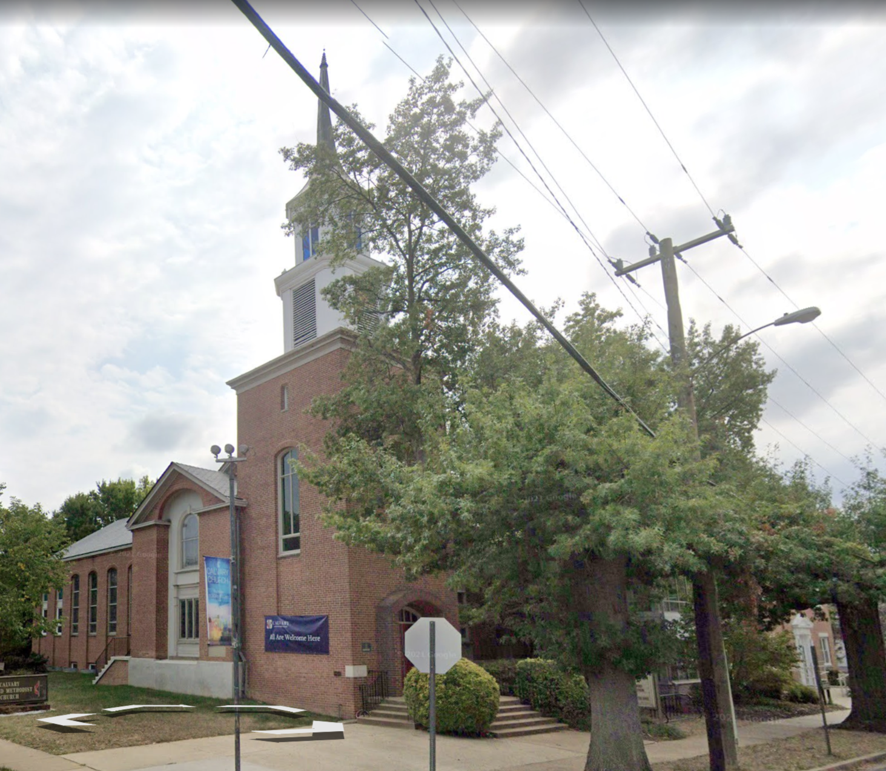
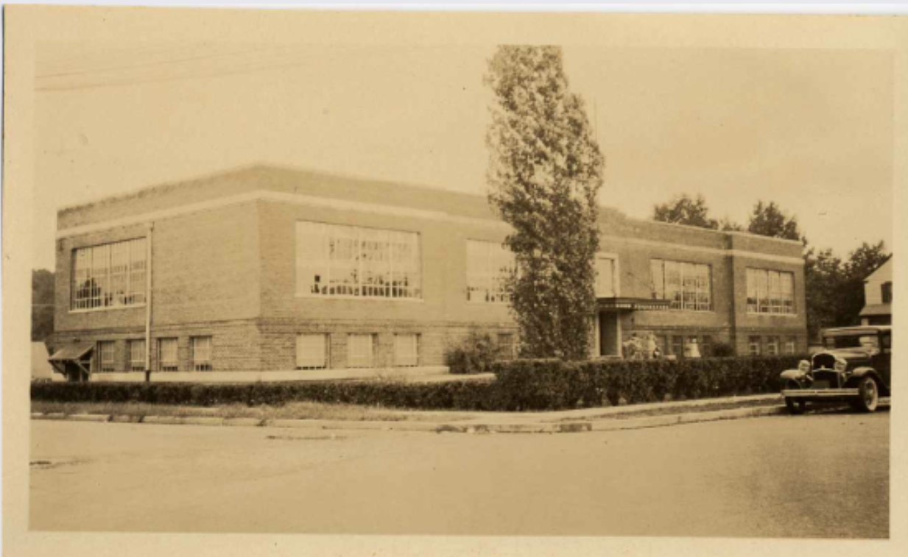
The Existing Site
SITE IS IN THE MIDDLE OF A LOW DENSITY R-6 SINGLE FAMILY HISTORICALLY DESIGNATED NEIGHBORHOOD – upzoning in R-6 is unprecedented
Site has a deed restriction for “school use only” that is being ignored.
School building is a “contributing building” to the historic district and has been accepted by HALRB for study as a Local Historic District (like other schools its age already are). Study is ongoing.
Site is next to a children’s park, heavily used by 5 daycares +++
Site is deeded for, planned for, designed for, needed for public use
FASHION
CENTER
HOFFMAN
BOSTON
HQ 2
COSTCO
RIVER
HOUSE
ARMY
NAVY
VA HIGHLANDS
CLARIDGE HOUSE
CRYSTAL
HOUSE
23rd ST
CC2DCA
BUS
GUNSTON /
OAKRIDGE
GIANT
WATER TREATMENT
APEX

Slide 11
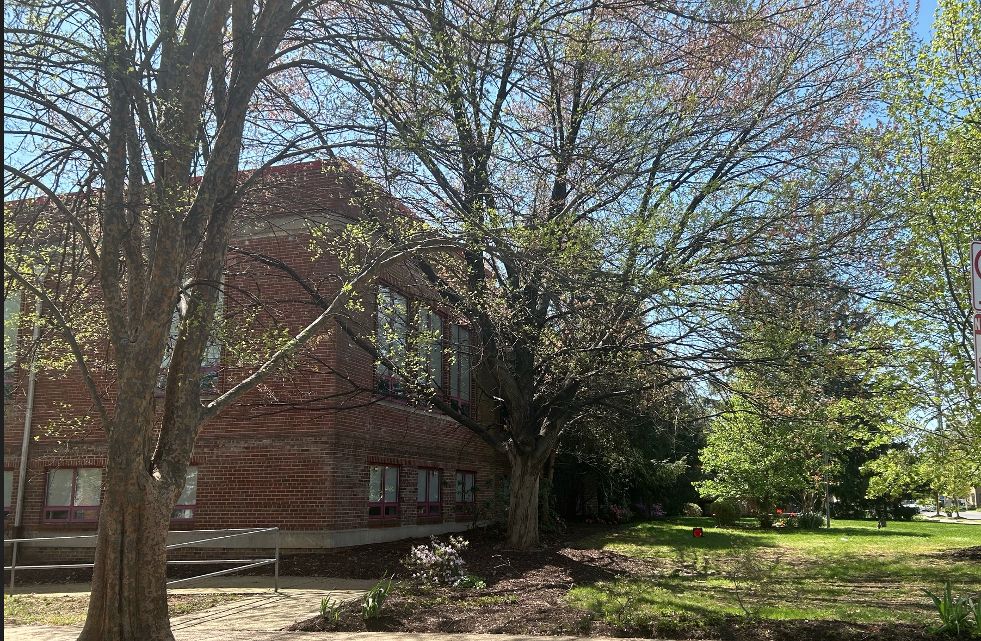
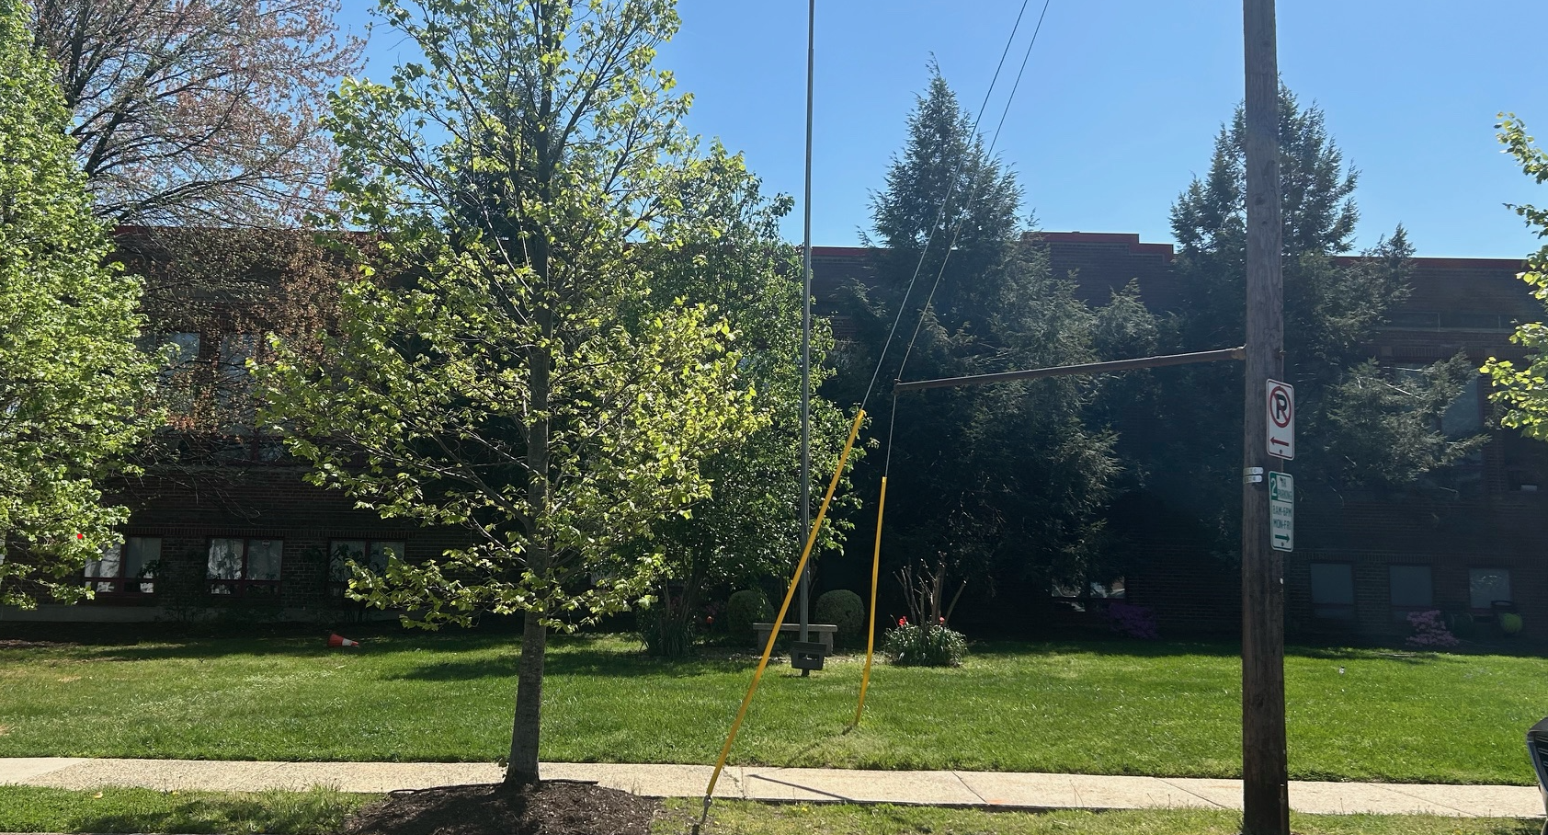
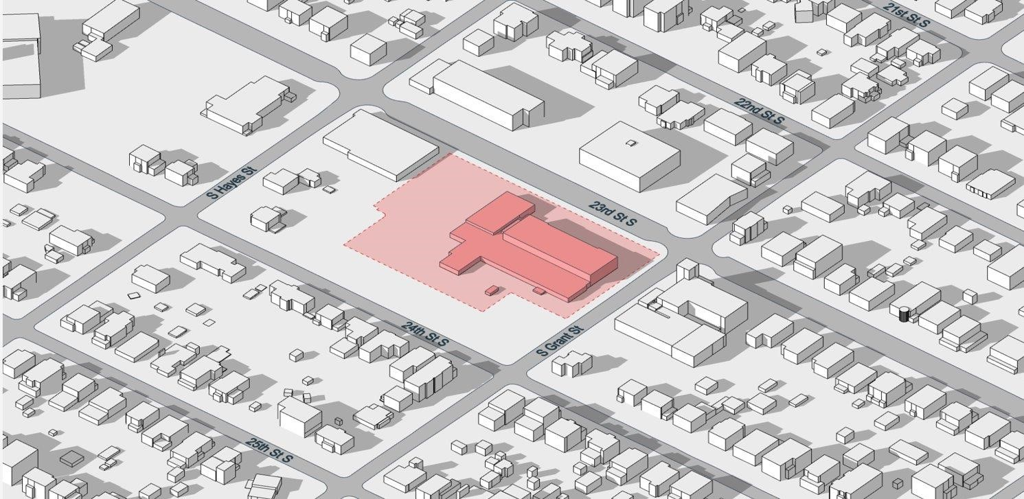
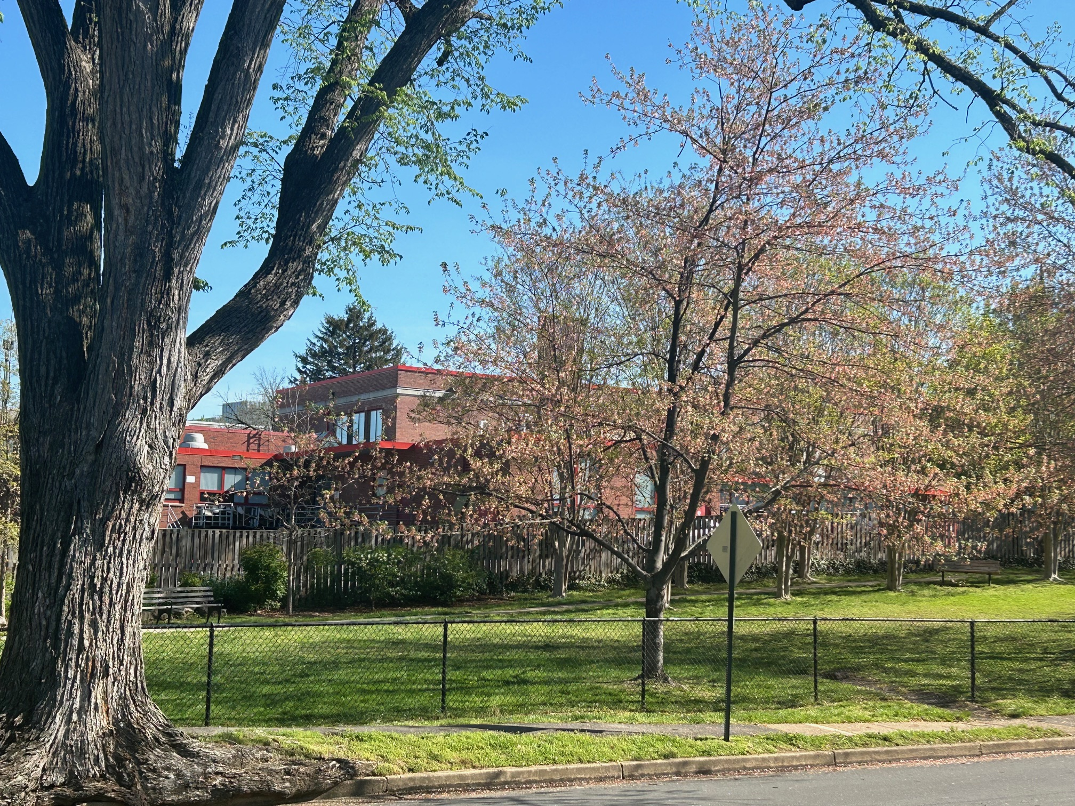
Existing Building
The diagram below shows about 27 that are homes directly in the sight line of 750 23rd Street, most are ~25’ tall.
In addition to other impacts of density (traffic, parking, noise), these single-family homes will be negatively impacted by the light pollution from the towering development.
Historic Nellie Custis School & Landscape – recently nominated as a Local Historic District, currently under review
Nelly Custis Park
Original Nellie Custis School c. 1923
Historic Aurora Highlands
Single Family Neighborhood
View of Nellie Custis School from residential 24th Street and Nelly Custis Park

Slide 12
Proposed Building

Slide 13
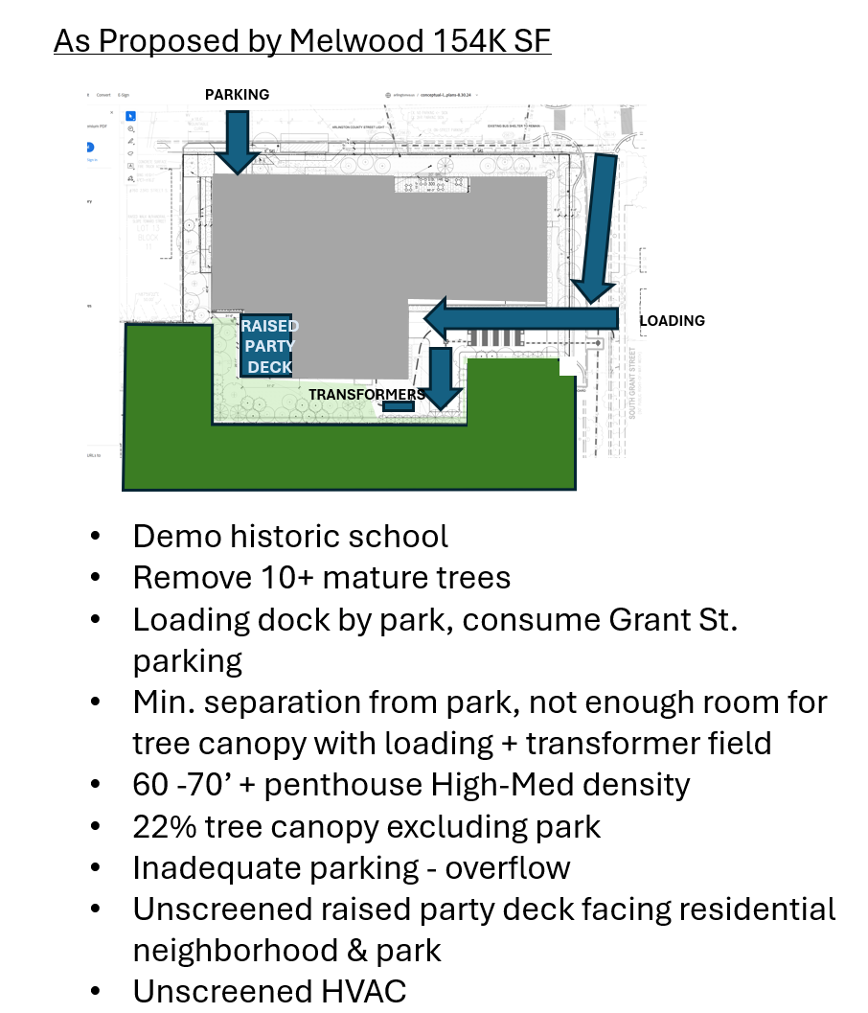
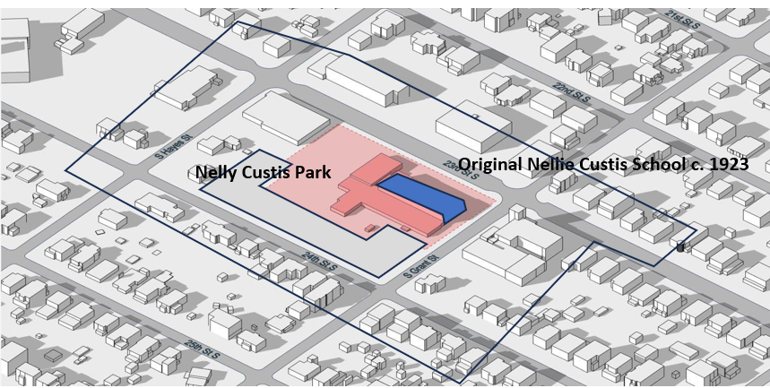
Existing Site
Parking Details
18,000 SF of Office & only 20 parking spaces (72 required) – 52 missing
105 large apartments & only 77 parking spaces (120 required, but this is not for family / TH size apts) 215 bedrooms.
Family size should have ~148 spaces. – 43 – 71 missing
Total missing parking: 95 – 123 spaces
Outside of ½ mile metro walkshed
1 mile from grocery

Slide 14
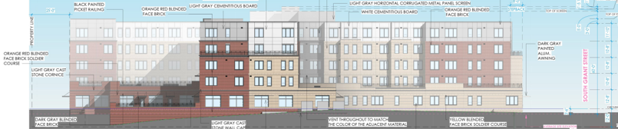
Wire diagram of 60’ and 45’ recommended height as seen from 24th Street South and Nelly Custis Park.
~60’
Because of the wide sight line across Nelly Custis Park building setbacks do not make much of a difference in reducing the perceived building mass. All increases in height are visible.
As you can see in the picture to the right even the ~25- 30’ Nellie Custis School on 23rd Street is completely visible a block away, from 24th Street, and any additional height added to it will be just as (and more) visible.
(Setbacks like those proposed in the Study can be effective on higher and tight urban sites due to limited sight lines, but don’t really do much in this situation.)
~45’

Slide 15
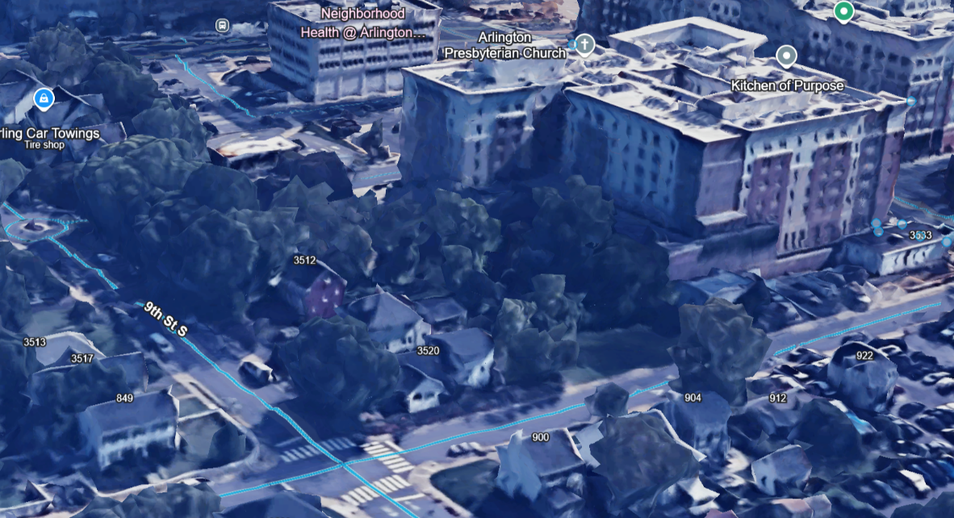
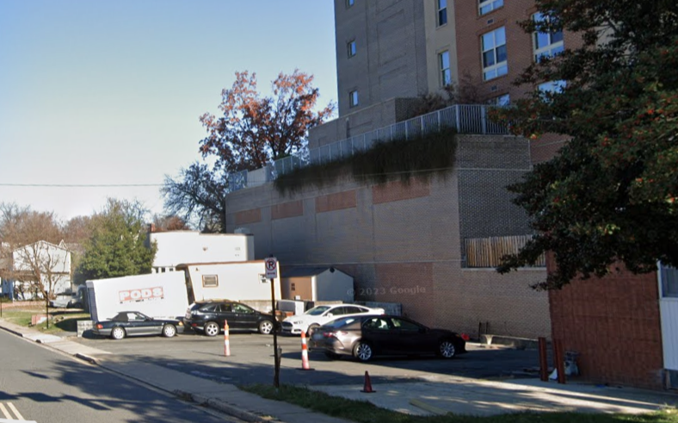
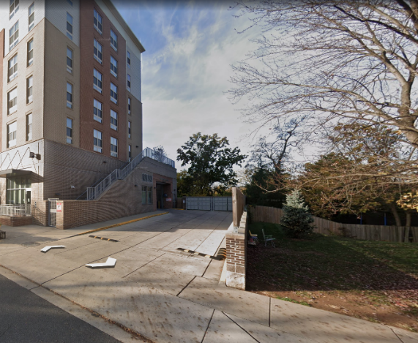
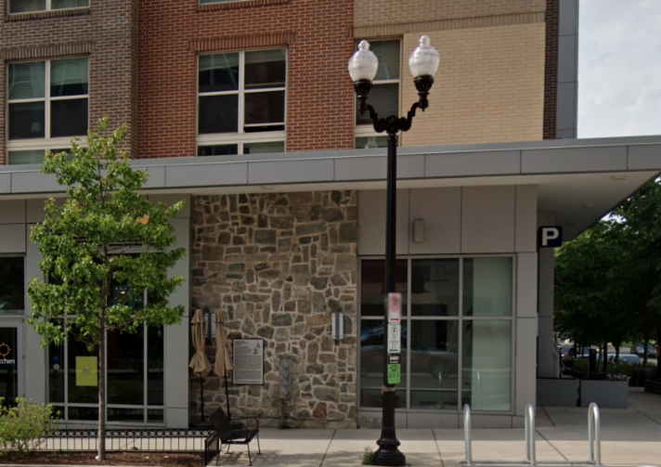
Pictures from Gilliam Place Example
Unscreened loading dock proposed next to Park
Buildings towering over residences – except this is not Columbia Pike, this is the middle of a neighborhood
Lack of screening – esp in winter
Historic “preservation” means a plaque on a wall

Slide 16
Planning Context

Slide 17
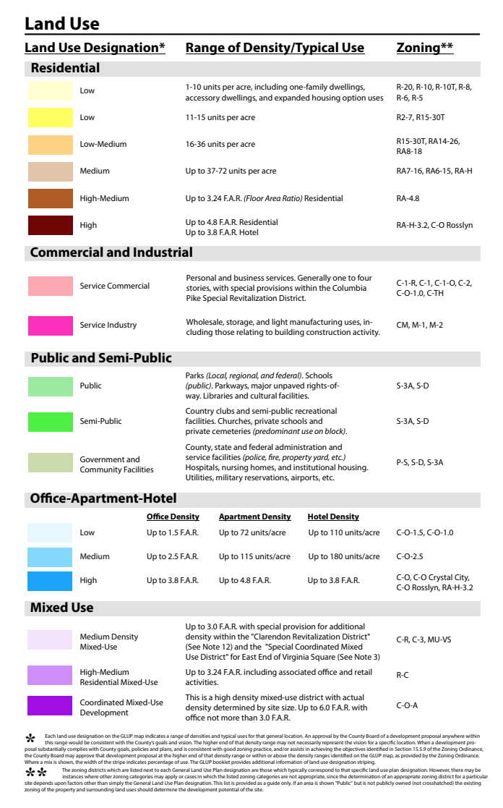
Existing Neighborhood
As Claimed in Application - but not really –aka townhouses
154K SF /1.79 Acre = 2.0 FAR
if it were part of the Sector Plan which it is not
aka Pentagon Center/ Costco Site
Proposed Envelope- if Resi Only
154K SF = 154 units possible = 86 units / acre
> 72 units / acre aka River House / Claridge
There are currently no high density (blue / purple) land uses outside of Planning Corridors. The Melwood Special GLUP Amendment would likely be the first approval of such high density in a low-density neighborhood and would set a negative precedent.

Slide 18
Potential GLUP Map with Melwood Precedent
Medium Density Office-Apartment-Hotel in every Low-Density area of Arlington.
High Density in Low Density Areas – precedent for the entire county
Neighborhoods are an endangered species

Slide 19
GLUP GUIDANCE
Page 6
Concentrate high-density residential, commercial and office development within designated Metro Station Areas in the Rosslyn-Ballston and Richmond Metrorail Transit Corridors. This policy encourages the use of public transit and reduces the use of motor vehicles.
FASHION
CENTER
HOFFMAN
BOSTON
HQ 2
COSTCO
RIVER
HOUSE
Page 6
ARMY
NAVY
VA HIGHLANDS
CLARIDGE HOUSE
Preserve and enhance existing single-family and apartment neighborhoods. Within Metro Station Areas, land use densities are concentrated near the Metro Station, tapering down to surrounding residential areas to limit the impacts of high-density development. Throughout the County, the Arlington Neighborhoods Program [NEIGHBORHOOD CONSERVATION AREA PLAN] and other community improvement programs help preserve and enhance older residential areas and help provide housing at a range of price levels and densities.
CRYSTAL
HOUSE
23rd ST
CC2DCA
BUS
GUNSTON /
OAKRIDGE
Page 2
If an area is shown “Public” but is not publicly owned (not crosshatched) the existing zoning of the property and surrounding land uses should determine the development potential of the site.
WAS NOT IN THE GLUP STUDY
Very few of these locations but Nellie Custis School is one of them
GIANT
WATER TREATMENT
APEX

Slide 20
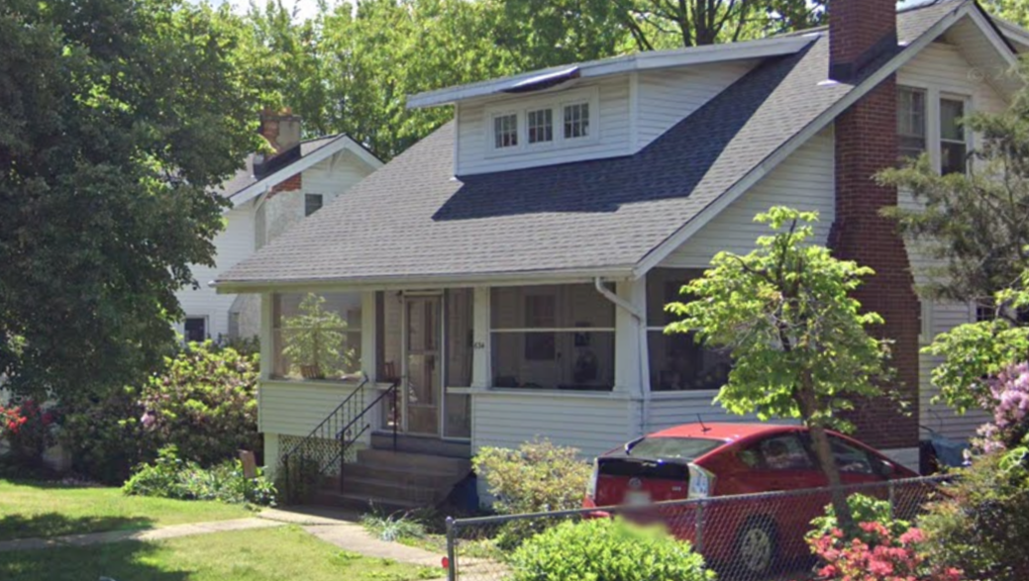
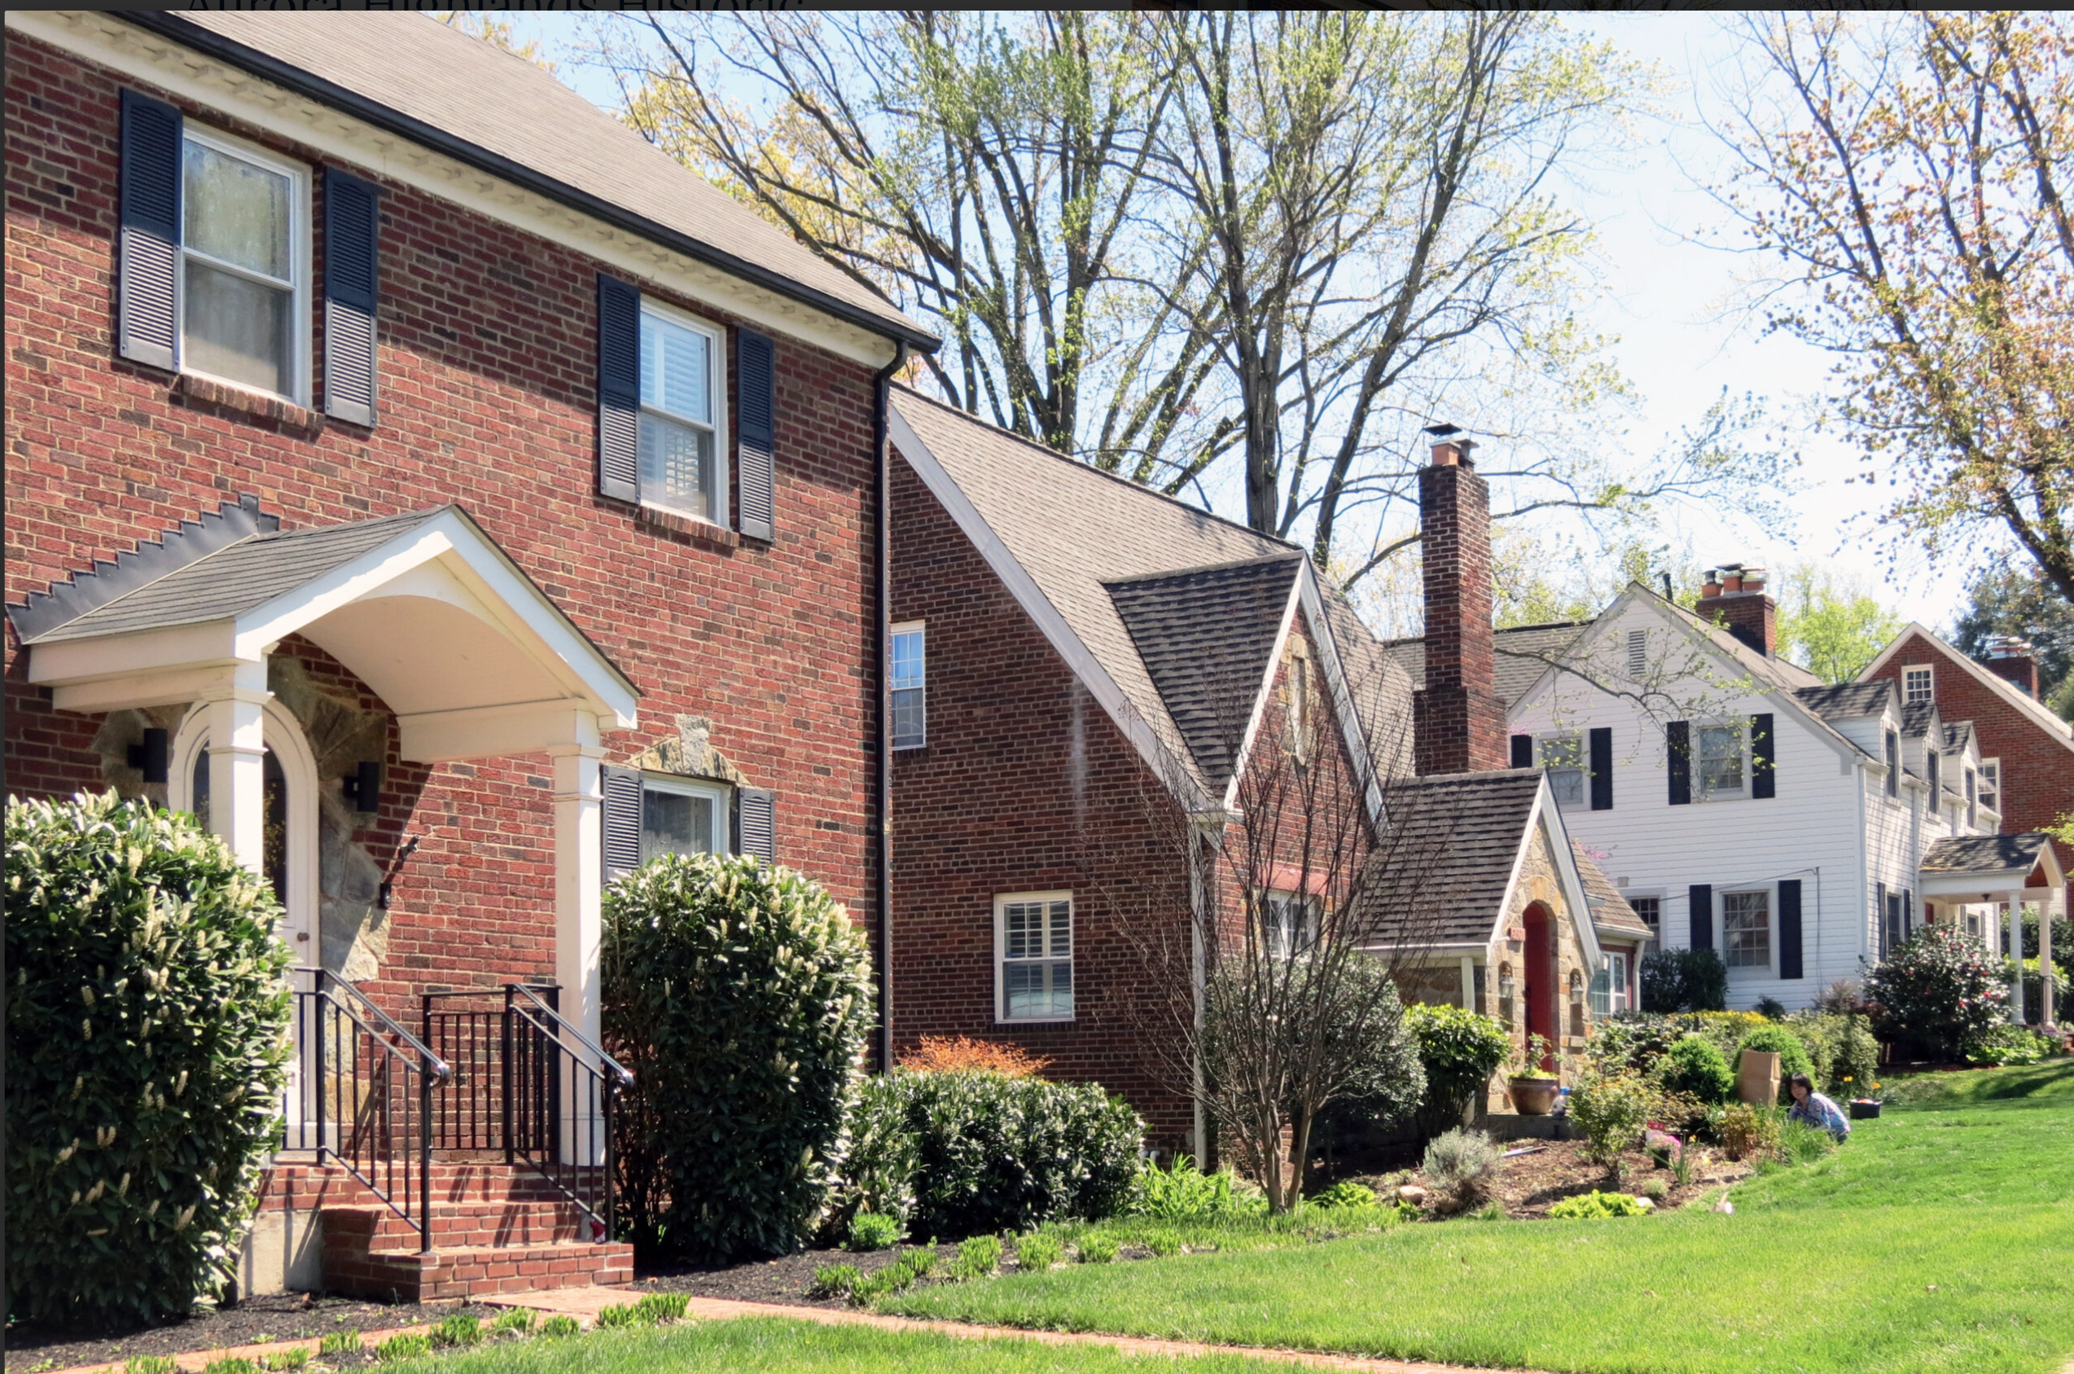
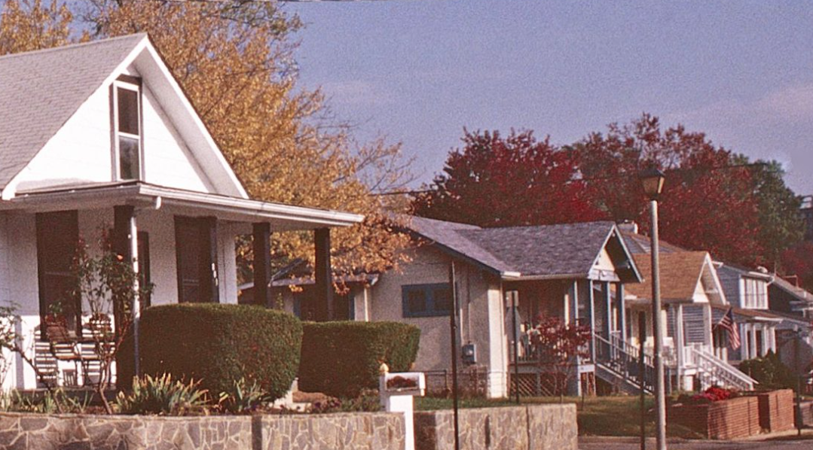
PROPOSAL IS IN THE MIDDLE OF A LOW DENSITY SINGLE FAMILY NEIGHBORHOOD – Bonus Density guidelines not met at all
per 12.3.7A, 25% bonus for affordable housing but the design must be
“appropriate for the site, project and the surrounding area”
per 15.5.9 3 (c)
“the site layout and building heights [shall] have been designed in a manner to establish effective transitions to lower density neighborhoods using site topography, landscaping, architectural façade treatments, graduated building heights, increased setbacks or other similar measures”
Nelly Custis Park
Original Nellie Custis School c. 1923

Slide 21
Alternative Envelope

Slide 22
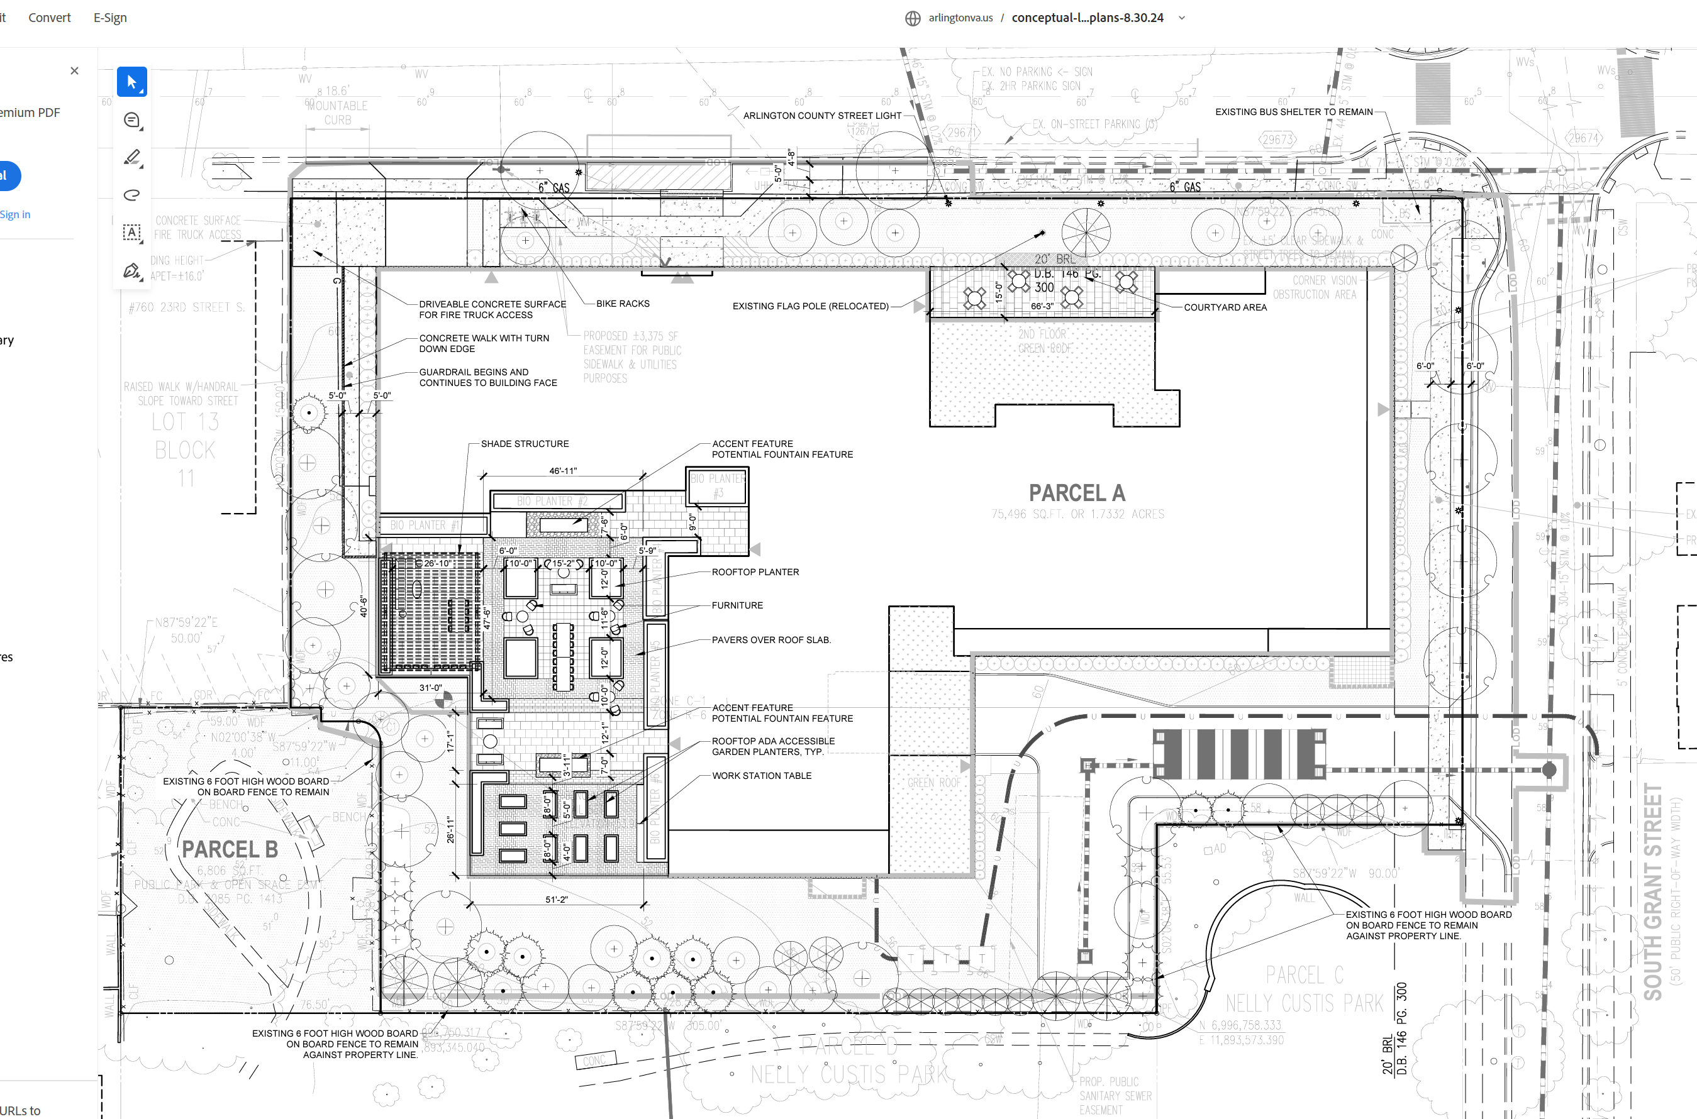
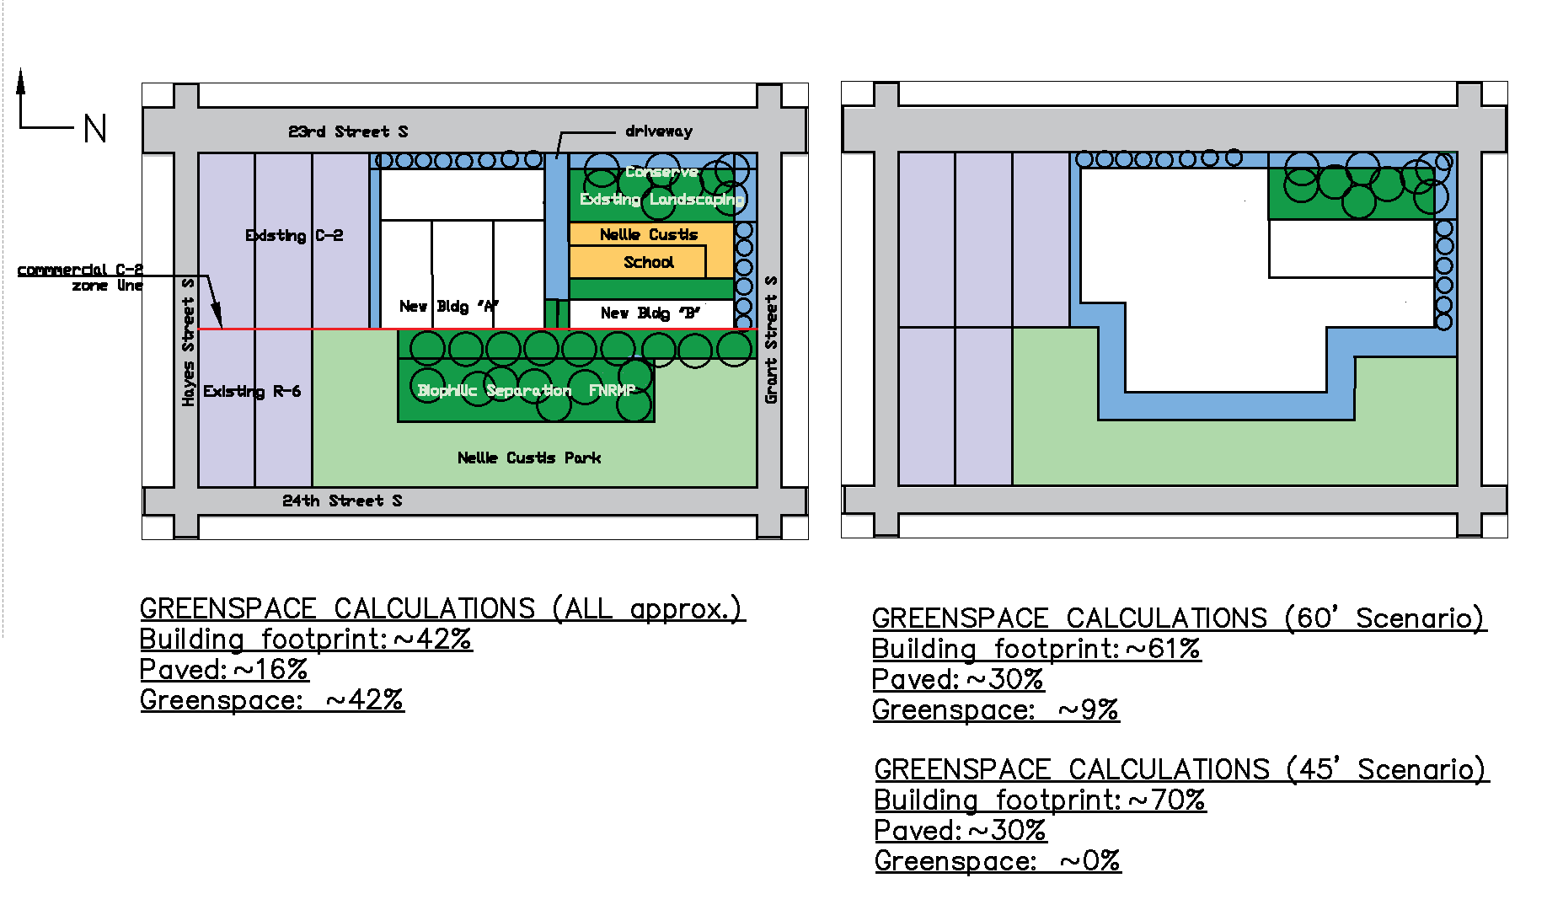
As Proposed by Melwood 154K SF
AHCA Alternative Envelope –
half the size, ~80K SF max
PARKING
LOADING & PKG
RAISED PARTY
DECK
LOADING
SIDEWALK EATS INTO PARK
TRANSFORMERS
Demo historic school
Remove 10+ mature trees
Loading dock by park, consume Grant St. parking
Min. separation from park, not enough room for tree canopy with loading + transformer field
60 -70’ + penthouse High-Med density
17% tree canopy excluding park
Inadequate parking - overflow
Unscreened raised party deck facing residential neighborhood & park
Unscreened HVAC
Adaptive reuse of the Nellie Custis School
Retain mature trees per GLUP Study
Parking entry and loading off of 23rd Street
Heavy separation from park – allows for tree canopy
35’ tall – actually Low- Med density
25%+ tree canopy excluding park – allows for open space, native / pollinator plantings
Adequate parking on-site / below
Solar roof potential

Slide 23
Summary

Slide 24
UPZONING IN R-6 IS UNPRECEDENTED & CREATES A PRECEDENT FOR DEVELOPERS TO UPZONE EVERYWHERE.
THE PROPOSED DENSITY IS UNPRECEDENTED IN THE MIDDLE OF A LOW DENSITY NEIGHBORHOOD
PUBLIC USE / NOT PUBLICLY OWNED > GUIDANCE IS TO LOOK AT EXISTING DENSITY
PUBLIC USE IS NEEDED FOR SCHOOLS & REQUIRED BY DEED
BUILDING IS AT LEAST 2x TOO MASSIVE FOR SITE
100+ PARKING OVERFLOW IN EXISTING SHARED AREA
NO PLAN FOR EXISTING CHURCH PARKING
TOO MUCH CONGESTION IS A SAFETY ISSUE – 23rd STREET XING, LOADING / PARKING ENTRANCE
DANGEROUS FOR CHILDREN TRAVELLING TO PARK
NOISE, FUMES, NO SEPARATION FROM PARK
DEMOLITION OF HISTORIC SCHOOL & MATURE TREES
INADEQUATE TREE CANOPY
EXACERBATES UNADDRESSED INEQUITY / OVERCROWDING IN SCHOOL
CORRALLING AFFORDABLE HOUSING IN SOUTH ARLINGTON
AURORA HIGHLANDS NEARLY UNANIMOUSLY VOTED TO OPPOSE IN MARCH 2022
NONE OF OUR MATERIAL COMMENTS HAVE BEEN ACKNOWLEDGED OR RESPONDED TO IN OVER 3 YEARS
MELWOOD & WALSH COLUCCI ARE POLITICALY CONNECTED BUT WE HAVE HAD NO REPRESENTATION
WILL YOU REPRESENT US?

Slide 25
Thank You!

