Slide 1
Melwood Site Plan Application 750 23rd Street S, Arlington
Meeting with Maureen Coffey
2/11/2025

Slide 2
Agenda
Summary of Concerns
Planning Context
Updates
Summary / Request

Slide 3
Summary of Concerns

Slide 4
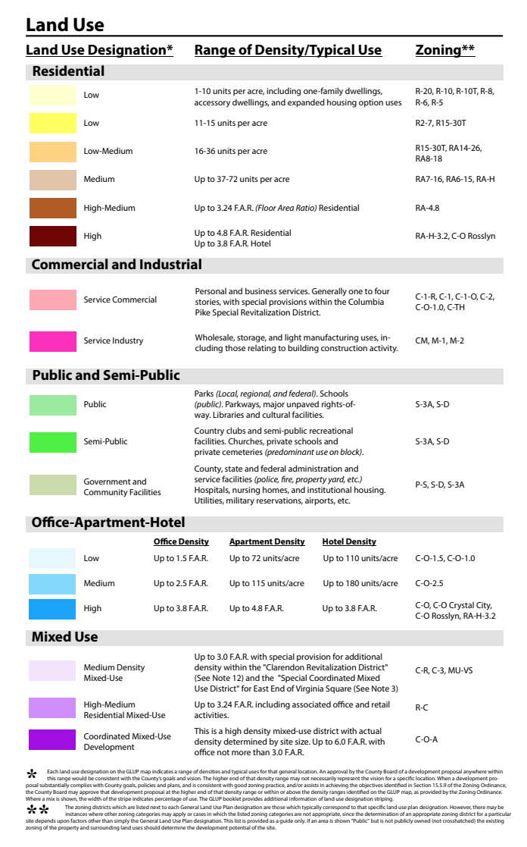
Existing Neighborhood
As Claimed in Application - but not really –aka townhouses
154K SF /1.79 Acre = 2.0 FAR
if it were part of the Sector Plan which it is not
aka Pentagon Center/ Costco Site
Proposed Envelope- if Resi Only
154K SF = 154 units possible = 86 units / acre
> 72 units / acre aka River House / Claridge
There are currently no high density (blue / purple) land uses outside of Planning Corridors. The Melwood Special GLUP Amendment would likely be the first approval of such high density in a low-density neighborhood and would set a negative precedent.

Slide 5
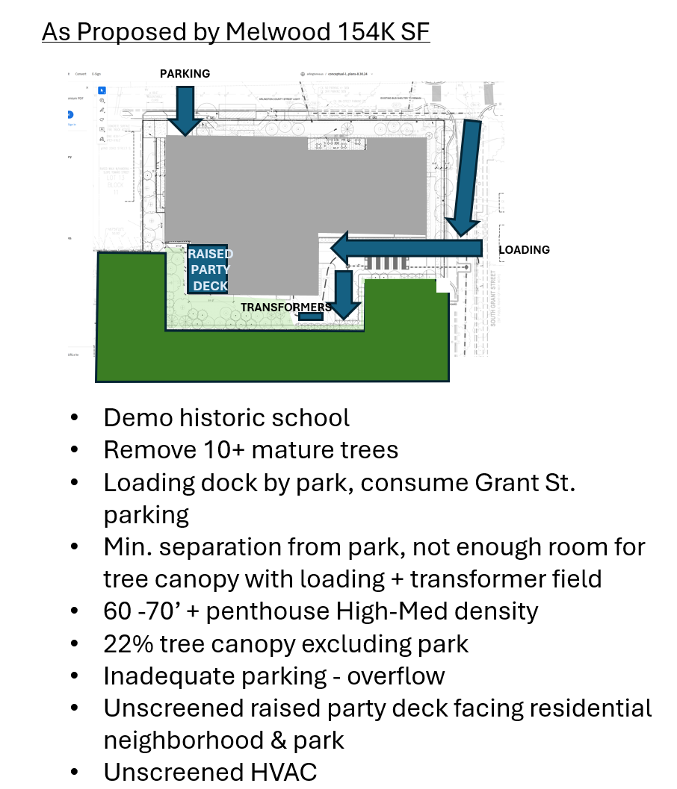
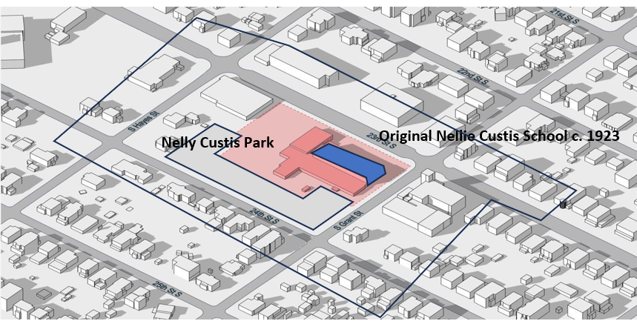
Existing Site
2nd FL
PARTY DECK
Parking Details
18,000 SF of Office & only 20 parking spaces (72 required) – 52 missing
105 large apartments & only 77 parking spaces (120 required, but this is not for family / TH size apts) 215 bedrooms.
Family size should have ~148 spaces. – 43 – 71 missing
Total missing parking: 95 – 123 spaces
Outside of ½ mile metro walkshed
1 mile from grocery

Slide 6
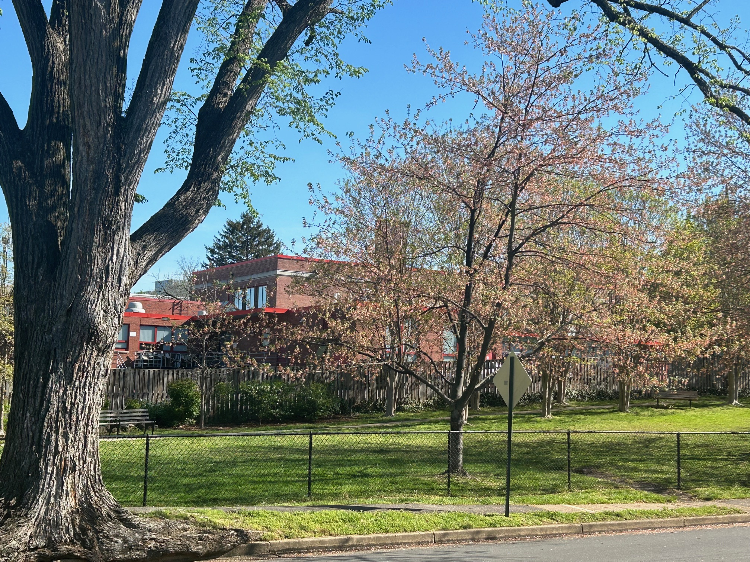
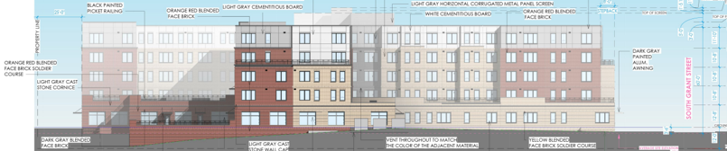
Wire diagram of 60’ and 45’ recommended height as seen from 24th Street South and Nelly Custis Park.
~60’
Because of the wide sight line across Nelly Custis Park building setbacks do not make much of a difference in reducing the perceived building mass. All increases in height are visible.
As you can see in the picture to the right even the ~25- 30’ Nellie Custis School on 23rd Street is completely visible a block away, from 24th Street, and any additional height added to it will be just as (and more) visible.
(Setbacks like those proposed in the Study can be effective on higher and tight urban sites due to limited sight lines, but don’t really do much in this situation.)
~45’

Slide 7
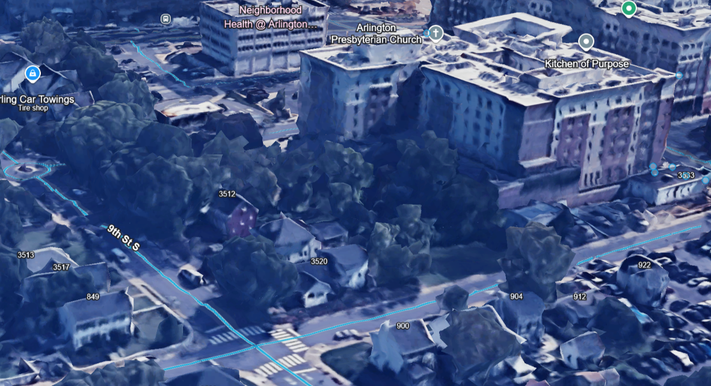
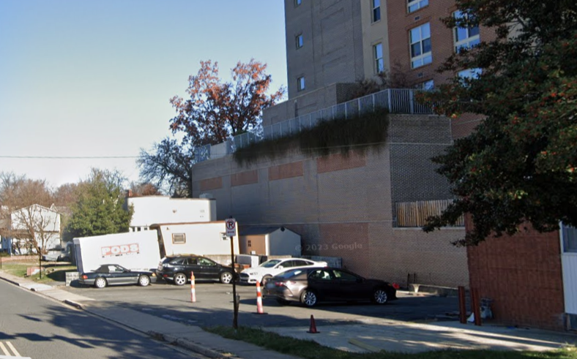
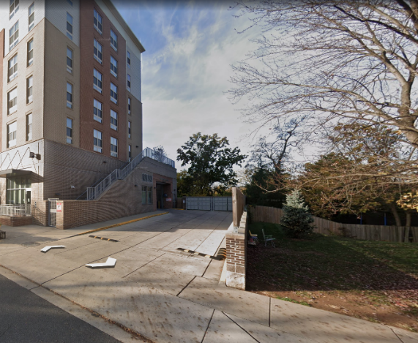
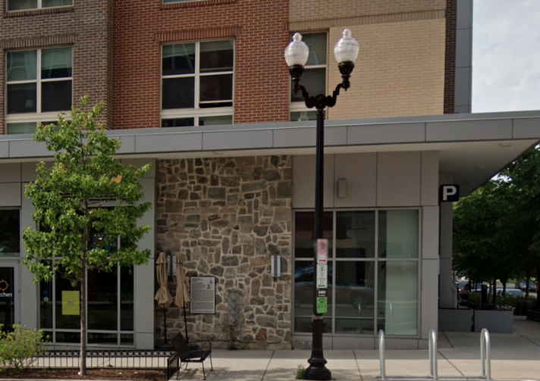
Pictures from Gilliam Place Example
Unscreened loading dock proposed next to Park
Buildings towering over residences – except this is not Columbia Pike, this is the middle of a neighborhood
Lack of screening – esp in winter
Historic “preservation” means a plaque on a wall

Slide 8
UPZONING IN R-6 IS UNPRECEDENTED & CREATES A PRECEDENT FOR DEVELOPERS TO UPZONE EVERYWHERE.
THE PROPOSED DENSITY IS UNPRECEDENTED IN THE MIDDLE OF A LOW DENSITY NEIGHBORHOOD
PUBLIC USE / NOT PUBLICLY OWNED > GUIDANCE IS TO LOOK AT EXISTING DENSITY
PUBLIC USE IS NEEDED FOR SCHOOLS & REQUIRED BY DEED
BUILDING IS AT LEAST 2x TOO MASSIVE FOR SITE
100+ PARKING OVERFLOW IN EXISTING SHARED AREA
NO PLAN FOR EXISTING CHURCH PARKING
TOO MUCH CONGESTION IS A SAFETY ISSUE – 23rd STREET XING, LOADING / PARKING ENTRANCE
DANGEROUS FOR CHILDREN TRAVELLING TO PARK
NOISE, FUMES, NO SEPARATION FROM PARK
DEMOLITION OF HISTORIC SCHOOL & MATURE TREES
INADEQUATE TREE CANOPY
EXACERBATES UNADDRESSED INEQUITY / OVERCROWDING IN SCHOOL
CORRALLING AFFORDABLE HOUSING IN SOUTH ARLINGTON
AURORA HIGHLANDS NEARLY UNANIMOUSLY VOTED TO OPPOSE IN MARCH 2022
NONE OF OUR MATERIAL COMMENTS HAVE BEEN ACKNOWLEDGED OR RESPONDED TO IN OVER 3 YEARS

Slide 9
Planning Context

Slide 10
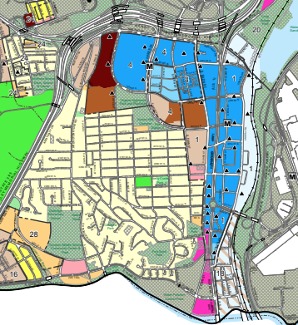
GLUP GUIDANCE
Page 6
Concentrate high-density residential, commercial and office development within designated Metro Station Areas in the Rosslyn-Ballston and Richmond Metrorail Transit Corridors. This policy encourages the use of public transit and reduces the use of motor vehicles.
FASHION
CENTER
HOFFMAN
BOSTON
HQ 2
COSTCO
RIVER
HOUSE
Page 6
ARMY
NAVY
VA HIGHLANDS
CLARIDGE HOUSE
Preserve and enhance existing single-family and apartment neighborhoods. Within Metro Station Areas, land use densities are concentrated near the Metro Station, tapering down to surrounding residential areas to limit the impacts of high-density development. Throughout the County, the Arlington Neighborhoods Program [NEIGHBORHOOD CONSERVATION AREA PLAN] and other community improvement programs help preserve and enhance older residential areas and help provide housing at a range of price levels and densities.
CRYSTAL
HOUSE
23rd ST
CC2DCA
BUS
GUNSTON /
OAKRIDGE
Page 2
If an area is shown “Public” but is not publicly owned (not crosshatched) the existing zoning of the property and surrounding land uses should determine the development potential of the site.
WAS NOT IN THE GLUP STUDY
Very few of these locations but Nellie Custis School is one of them
GIANT
WATER TREATMENT
APEX

Slide 11
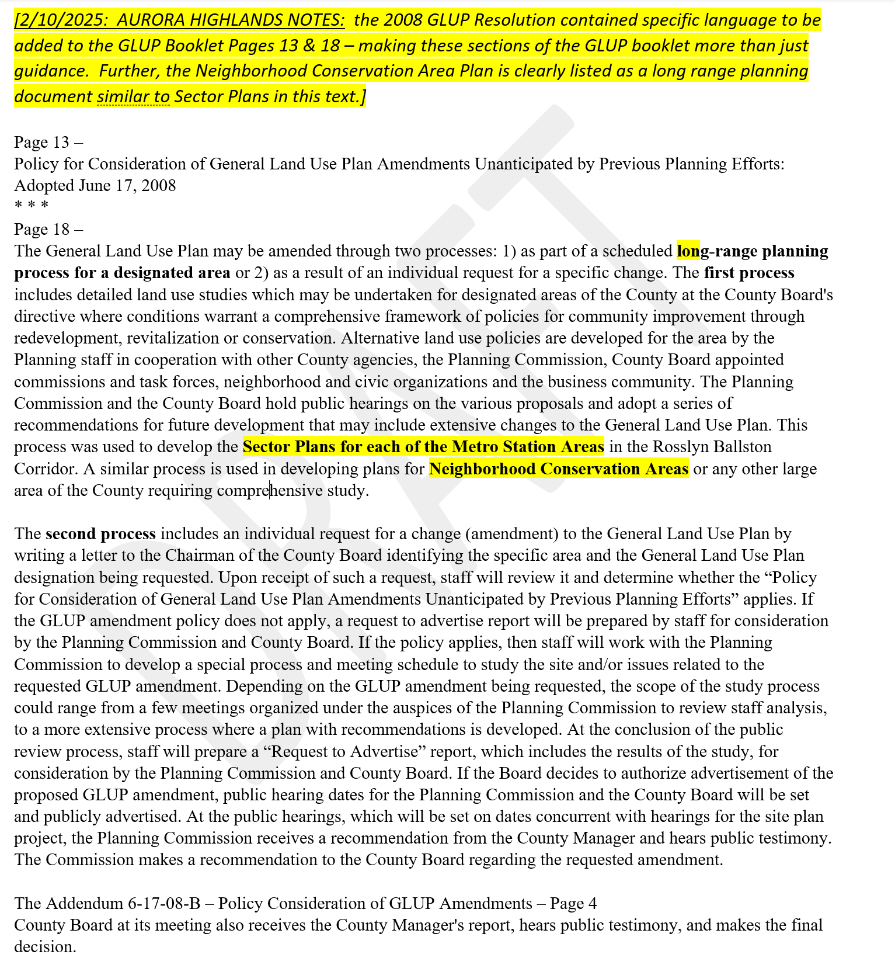
GLUP Research to 2008
Original Resolution – language in GLUP booklet is from resolution – not just guidance, includes NC Area Plans.

Slide 12
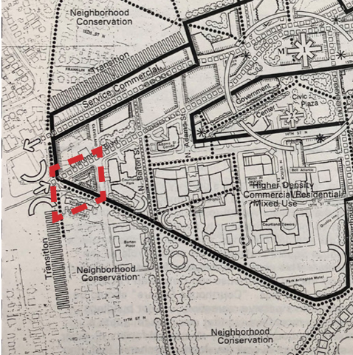
Map of Courthouse Sector Plan with adjacent Neighborhood Conservation Area and Transition Zones

Slide 13
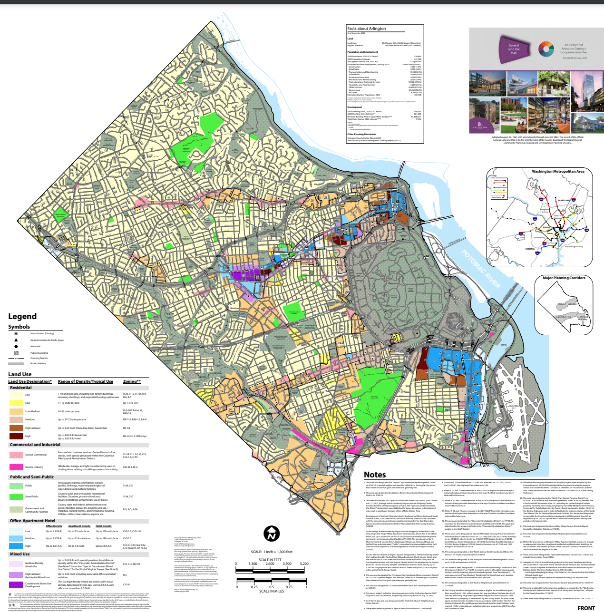
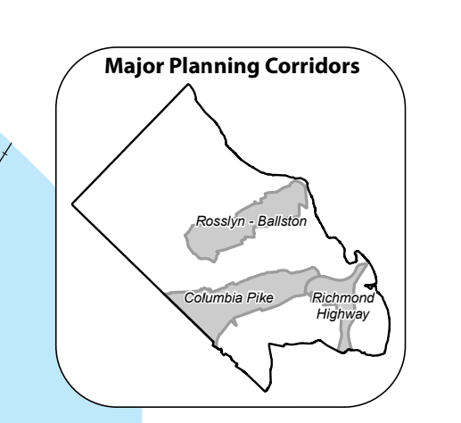
The General Land Use Plan (GLUP) – Planning corridor overlay approximated – see inset upper right.

Slide 14
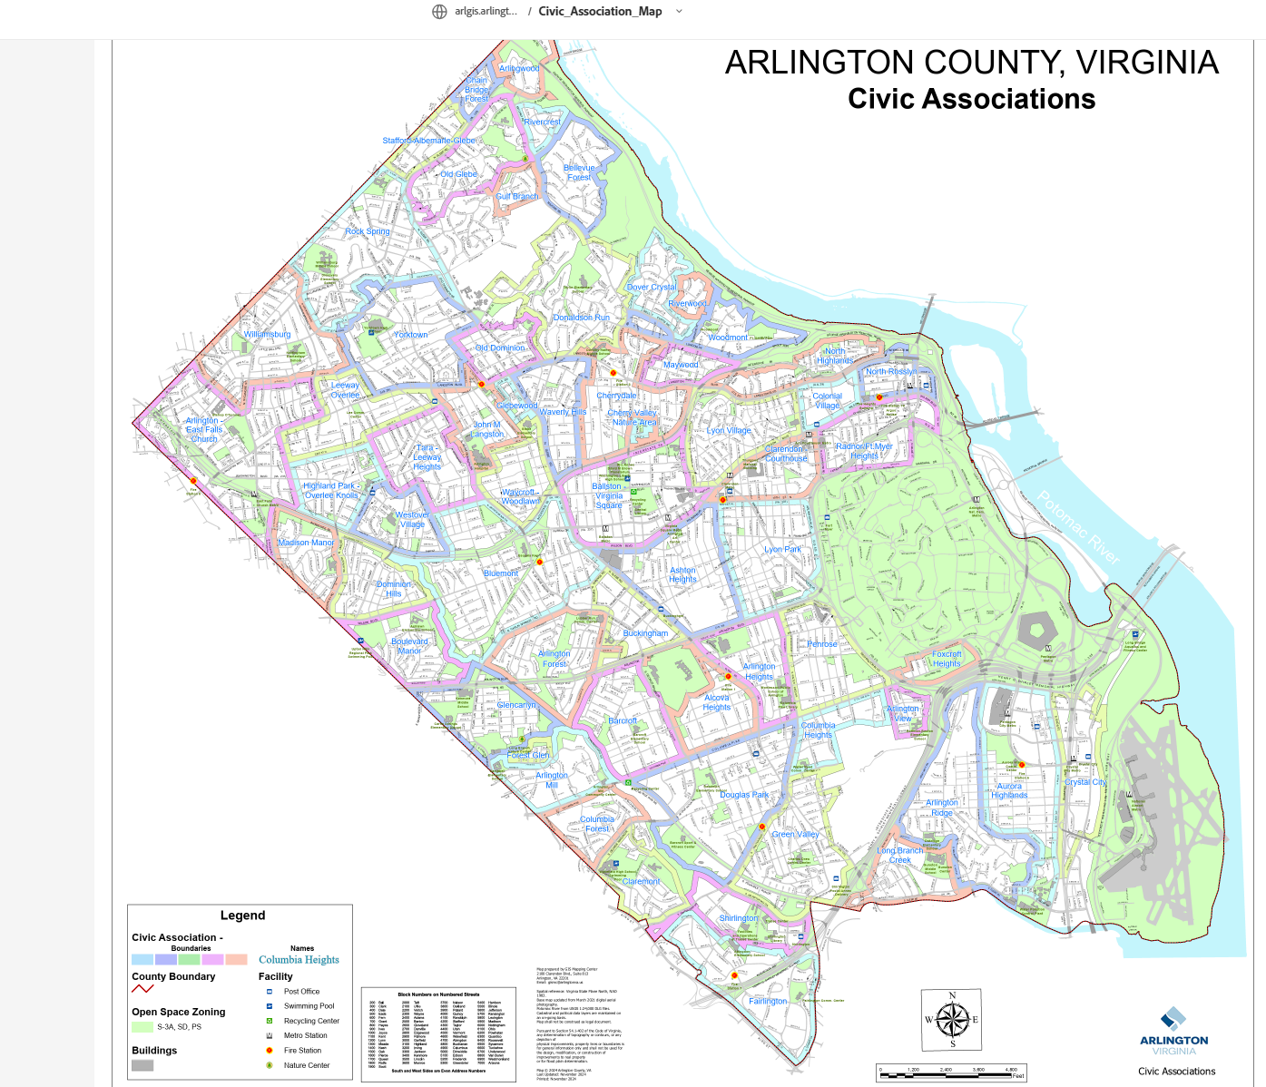
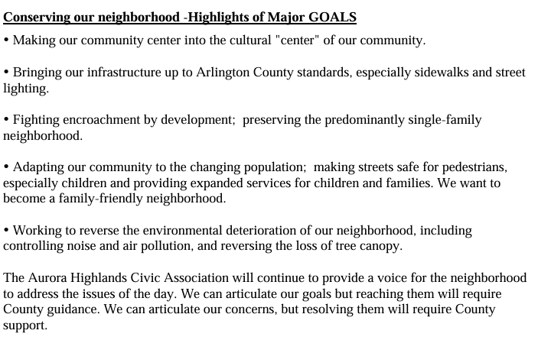
https://www.arlingtonva.us/files/sharedassets/public/Projects/Documents/NC_AuroraHighlands_Plan.pdf
2008 AURORA HIGHLANDS NC PLAN
NO NEIGHBORHOOD CONSERVATION AREA PLAN
YES NEIGHBORHOOD CONSERVATION AREA PLAN

Slide 15
GLUP History & Trends
2008 – 2016 no neighborhood opposition - not in SF neighborhoods
Post 2017 mostly opposed by SF neighborhoods, starting with 11th & Vermont

Slide 16
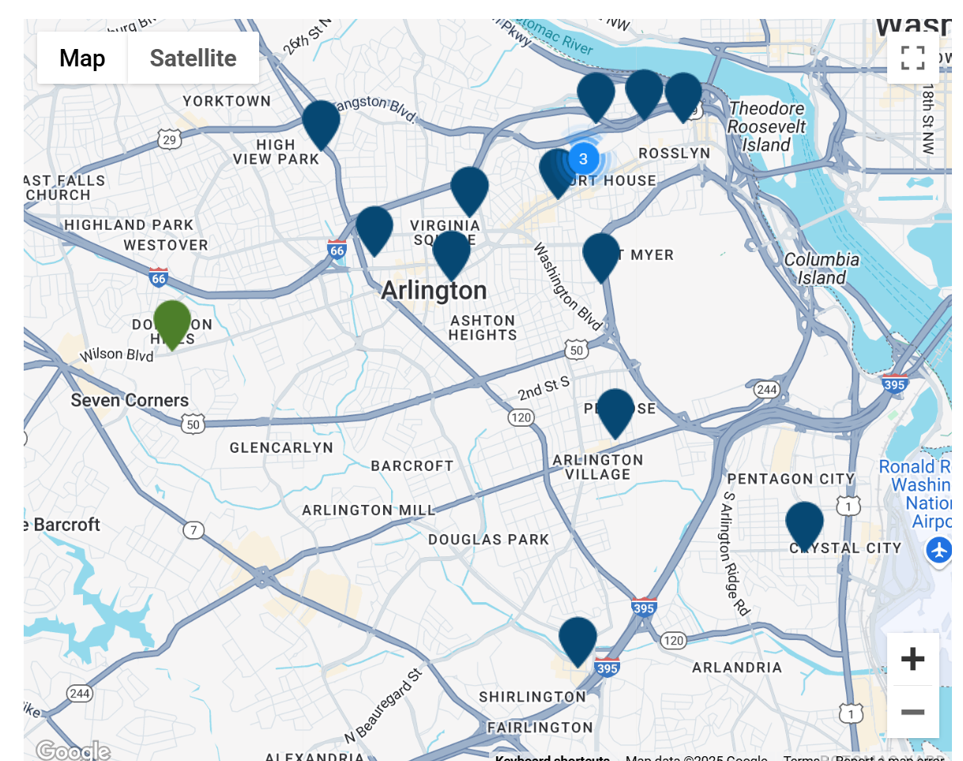
GLUP Studies Map
2011
2011
2015
Sun - 2023
BVS 2017
2011
2017 11th & Vermont 2017 Wash & Kirk
2021 Pershing
2022 Courthouse
2023 Sunrise
2025 Melwood
?? Dom Hills
CH 2022
BVS 2017
P 2021
https://www.arlingtonva.us/Government/Projects/Plans-Studies/General-Land-Use-Plan/Studies
2018
??
M - 2025
2020
??

Slide 17
2008 AURORA HIGHLANDS NC PLAN
S –’23
BVS ‘17
TBD
P – ‘21
CH –’22
NO NEIGHBORHOOD CONSERVATION AREA PLAN
YES NEIGHBORHOOD CONSERVATION AREA PLAN
M –’25

Slide 18
Updates

Slide 19
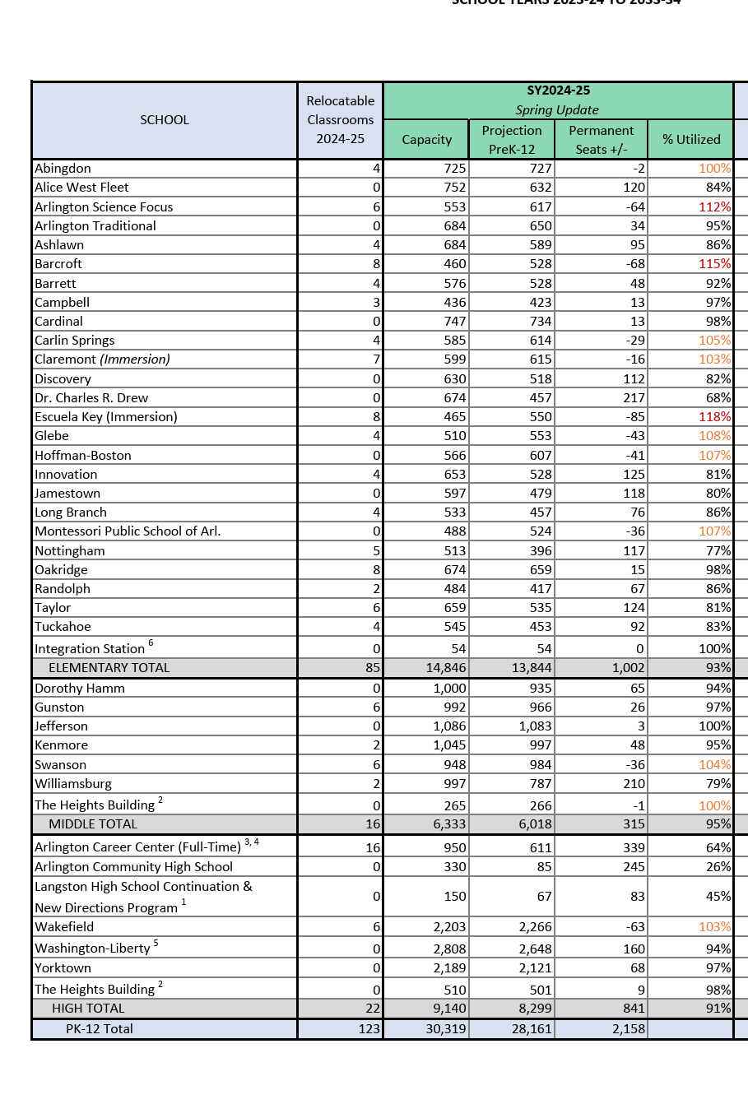
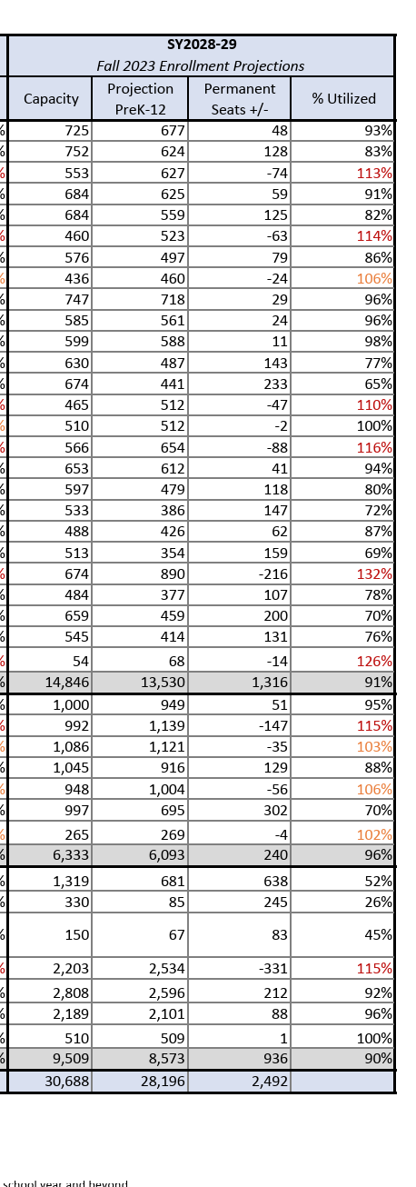
Population has doubled since 2000 &
growth is not stopping +
2024
Oakridge
96% capacity including 8 trailers
Gunston
97% capacity including 6 trailers
Wakefield
103% capacity including 6 trailers
2028
Oakridge
132% over including 8 trailers –
216 PERMANENT SEATS OVER AFTER INCLUDING TRAILERS
Gunston
115% over including 6 trailers
147 PERM SEATS OVER AFTER TRAILERS
Wakefield
115% including 6 trailers
331 PERM SEATS OVER AFTER TRAILERS
+Melwood 67 Seats
Increasing density > increasing schools, parks, library, community center, traffic – where is the planning??

Slide 20
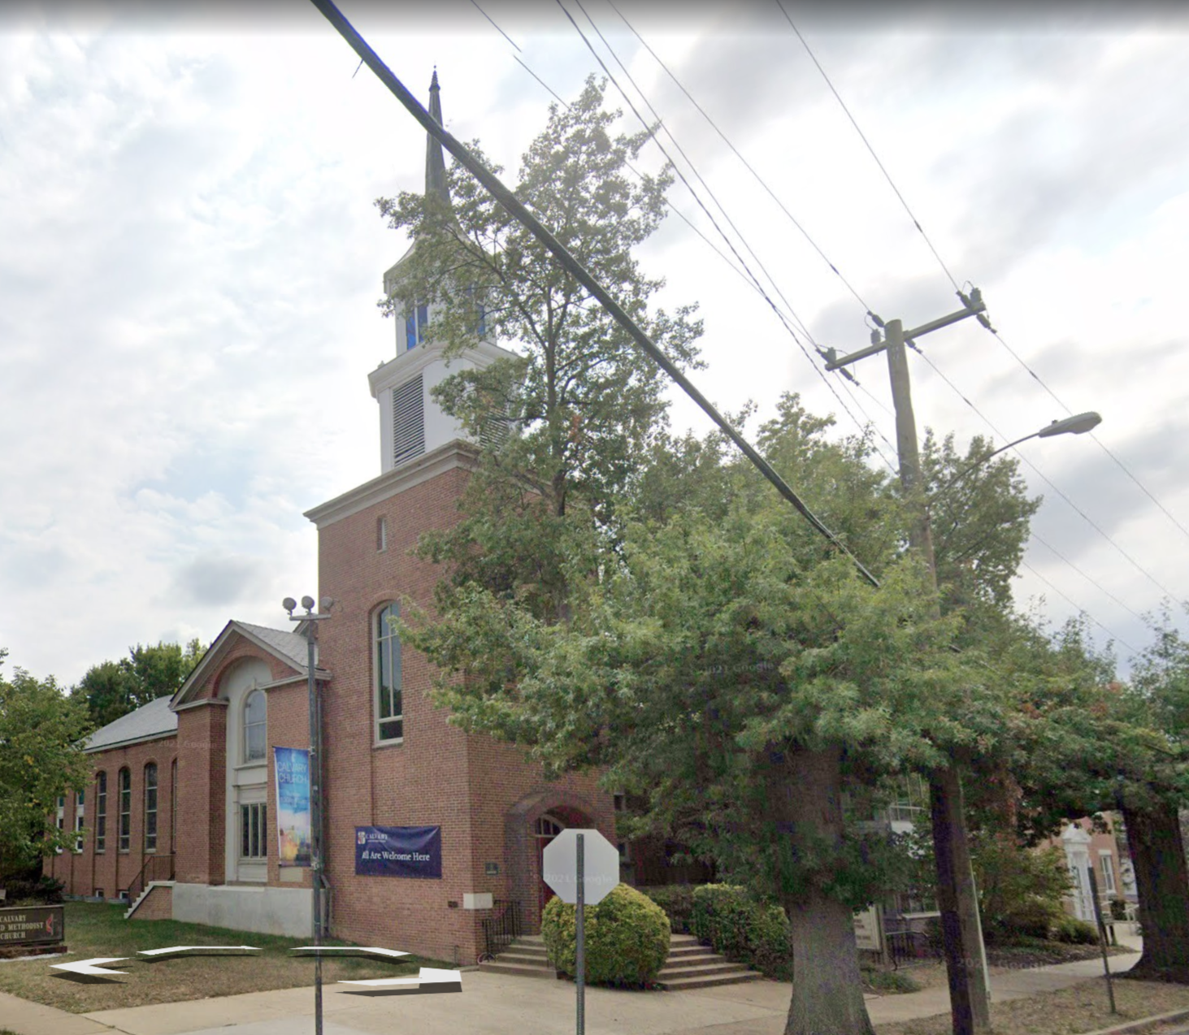
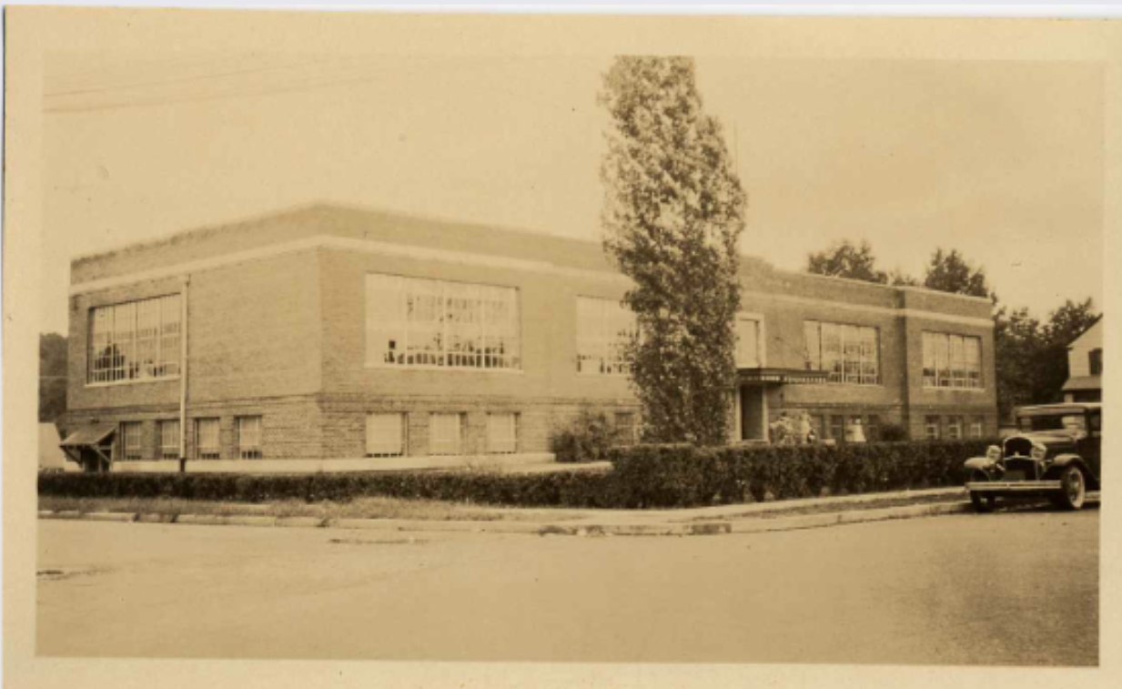
The Existing Site
SITE IS IN THE MIDDLE OF A LOW DENSITY R-6 SINGLE FAMILY HISTORICALLY DESIGNATED NEIGHBORHOOD – upzoning in R-6 is unprecedented
Site has a deed restriction for “school use only” that is being ignored.
School building is a “contributing building” to the historic district and has been accepted by HALRB for study as a Local Historic District (like other schools its age already are). Study is ongoing.
Site is next to a children’s park, heavily used by 5 daycares +++
Site is deeded for, planned for, designed for, needed for public use
FASHION
CENTER
HOFFMAN
BOSTON
HQ 2
COSTCO
RIVER
HOUSE
ARMY
NAVY
VA HIGHLANDS
CLARIDGE HOUSE
CRYSTAL
HOUSE
23rd ST
CC2DCA
BUS
GUNSTON /
OAKRIDGE
GIANT
WATER TREATMENT
APEX

Slide 21
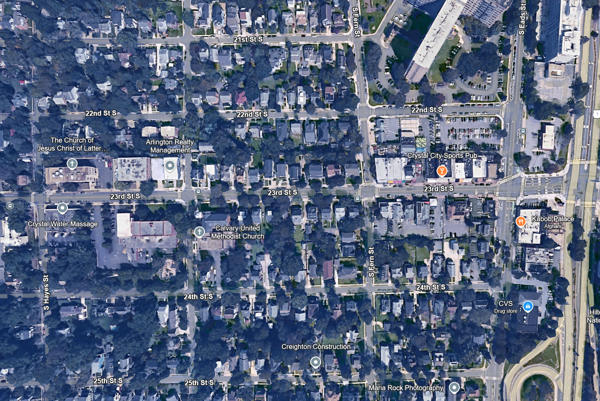
Nelly Custis School
~20,000 SF > ~200 children = K-1 overflow
CH Site is Approx 120 x 220 ft = ~26,400 SF
Parking / floor ~85 spaces
Below Grade 1: Parking for Melwood
Grade: Retail parking & Melwood Lobby
2nd Floor: overflow parking and utility
3rd Floor: Melwood
4th – 7th Floor: Apartments

Slide 22
Summary
Project does not meet GLUP guidelines:
Excludes NC Area Plan Guiding Document
Ignores GLUP Map Note 2 “public / not publicly owned” adjacent zoning applies
Precedent Upzoning in R-6 Low Density Neighborhood, not per GLUP Policy
GLUP Study: 45’ foot does not allow tree coverage & 60’ too tall – building is just too big
Not stepped back on east / west
Other issues
70 spaces for 215 bedrooms is inadequate
Nuisance on park & residences – party deck, lack of screening, light pollution
Ongoing HALRB Study – HALRB request to defer approval until they act on LHD
School overcrowding, yet this site is a unique opportunity
Request: DEFER for HALRB and do comprehensive planning – can the CH site work?

Slide 23
Thank You!

Slide 24
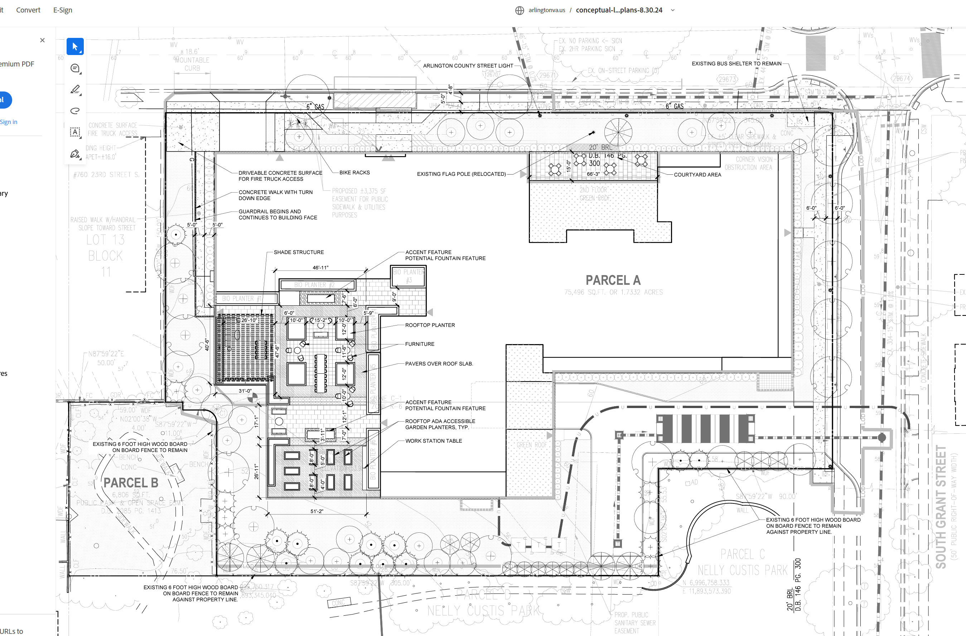
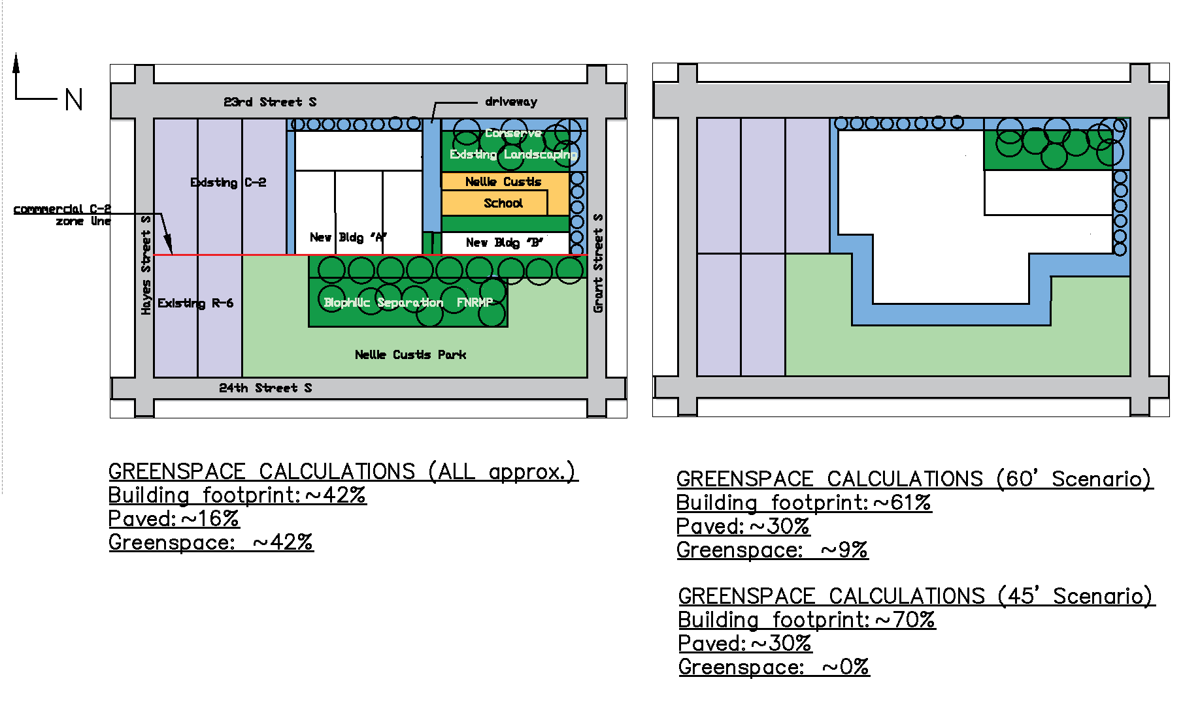
As Proposed by Melwood 154K SF
AHCA Alternative Envelope –
half the size, ~80K SF max
PARKING
LOADING & PKG
RAISED PARTY
DECK
LOADING
SIDEWALK EATS INTO PARK
TRANSFORMERS
Demo historic school
Remove 10+ mature trees
Loading dock by park, consume Grant St. parking
Min. separation from park, not enough room for tree canopy with loading + transformer field
60 -70’ + penthouse High-Med density
17% tree canopy excluding park
Inadequate parking - overflow
Unscreened raised party deck facing residential neighborhood & park
Unscreened HVAC
Adaptive reuse of the Nellie Custis School
Retain mature trees per GLUP Study
Parking entry and loading off of 23rd Street
Heavy separation from park – allows for tree canopy
35’ tall – actually Low- Med density
25%+ tree canopy excluding park – allows for open space, native / pollinator plantings
Adequate parking on-site / below
Solar roof potential

Slide 25
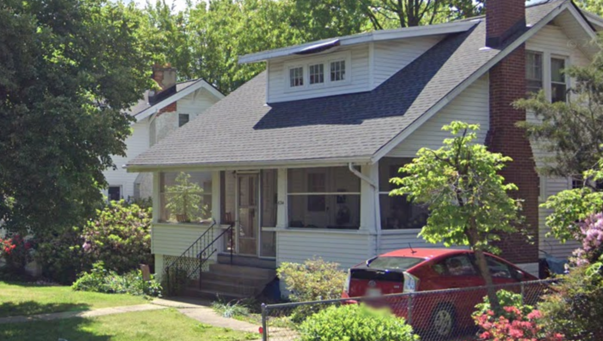
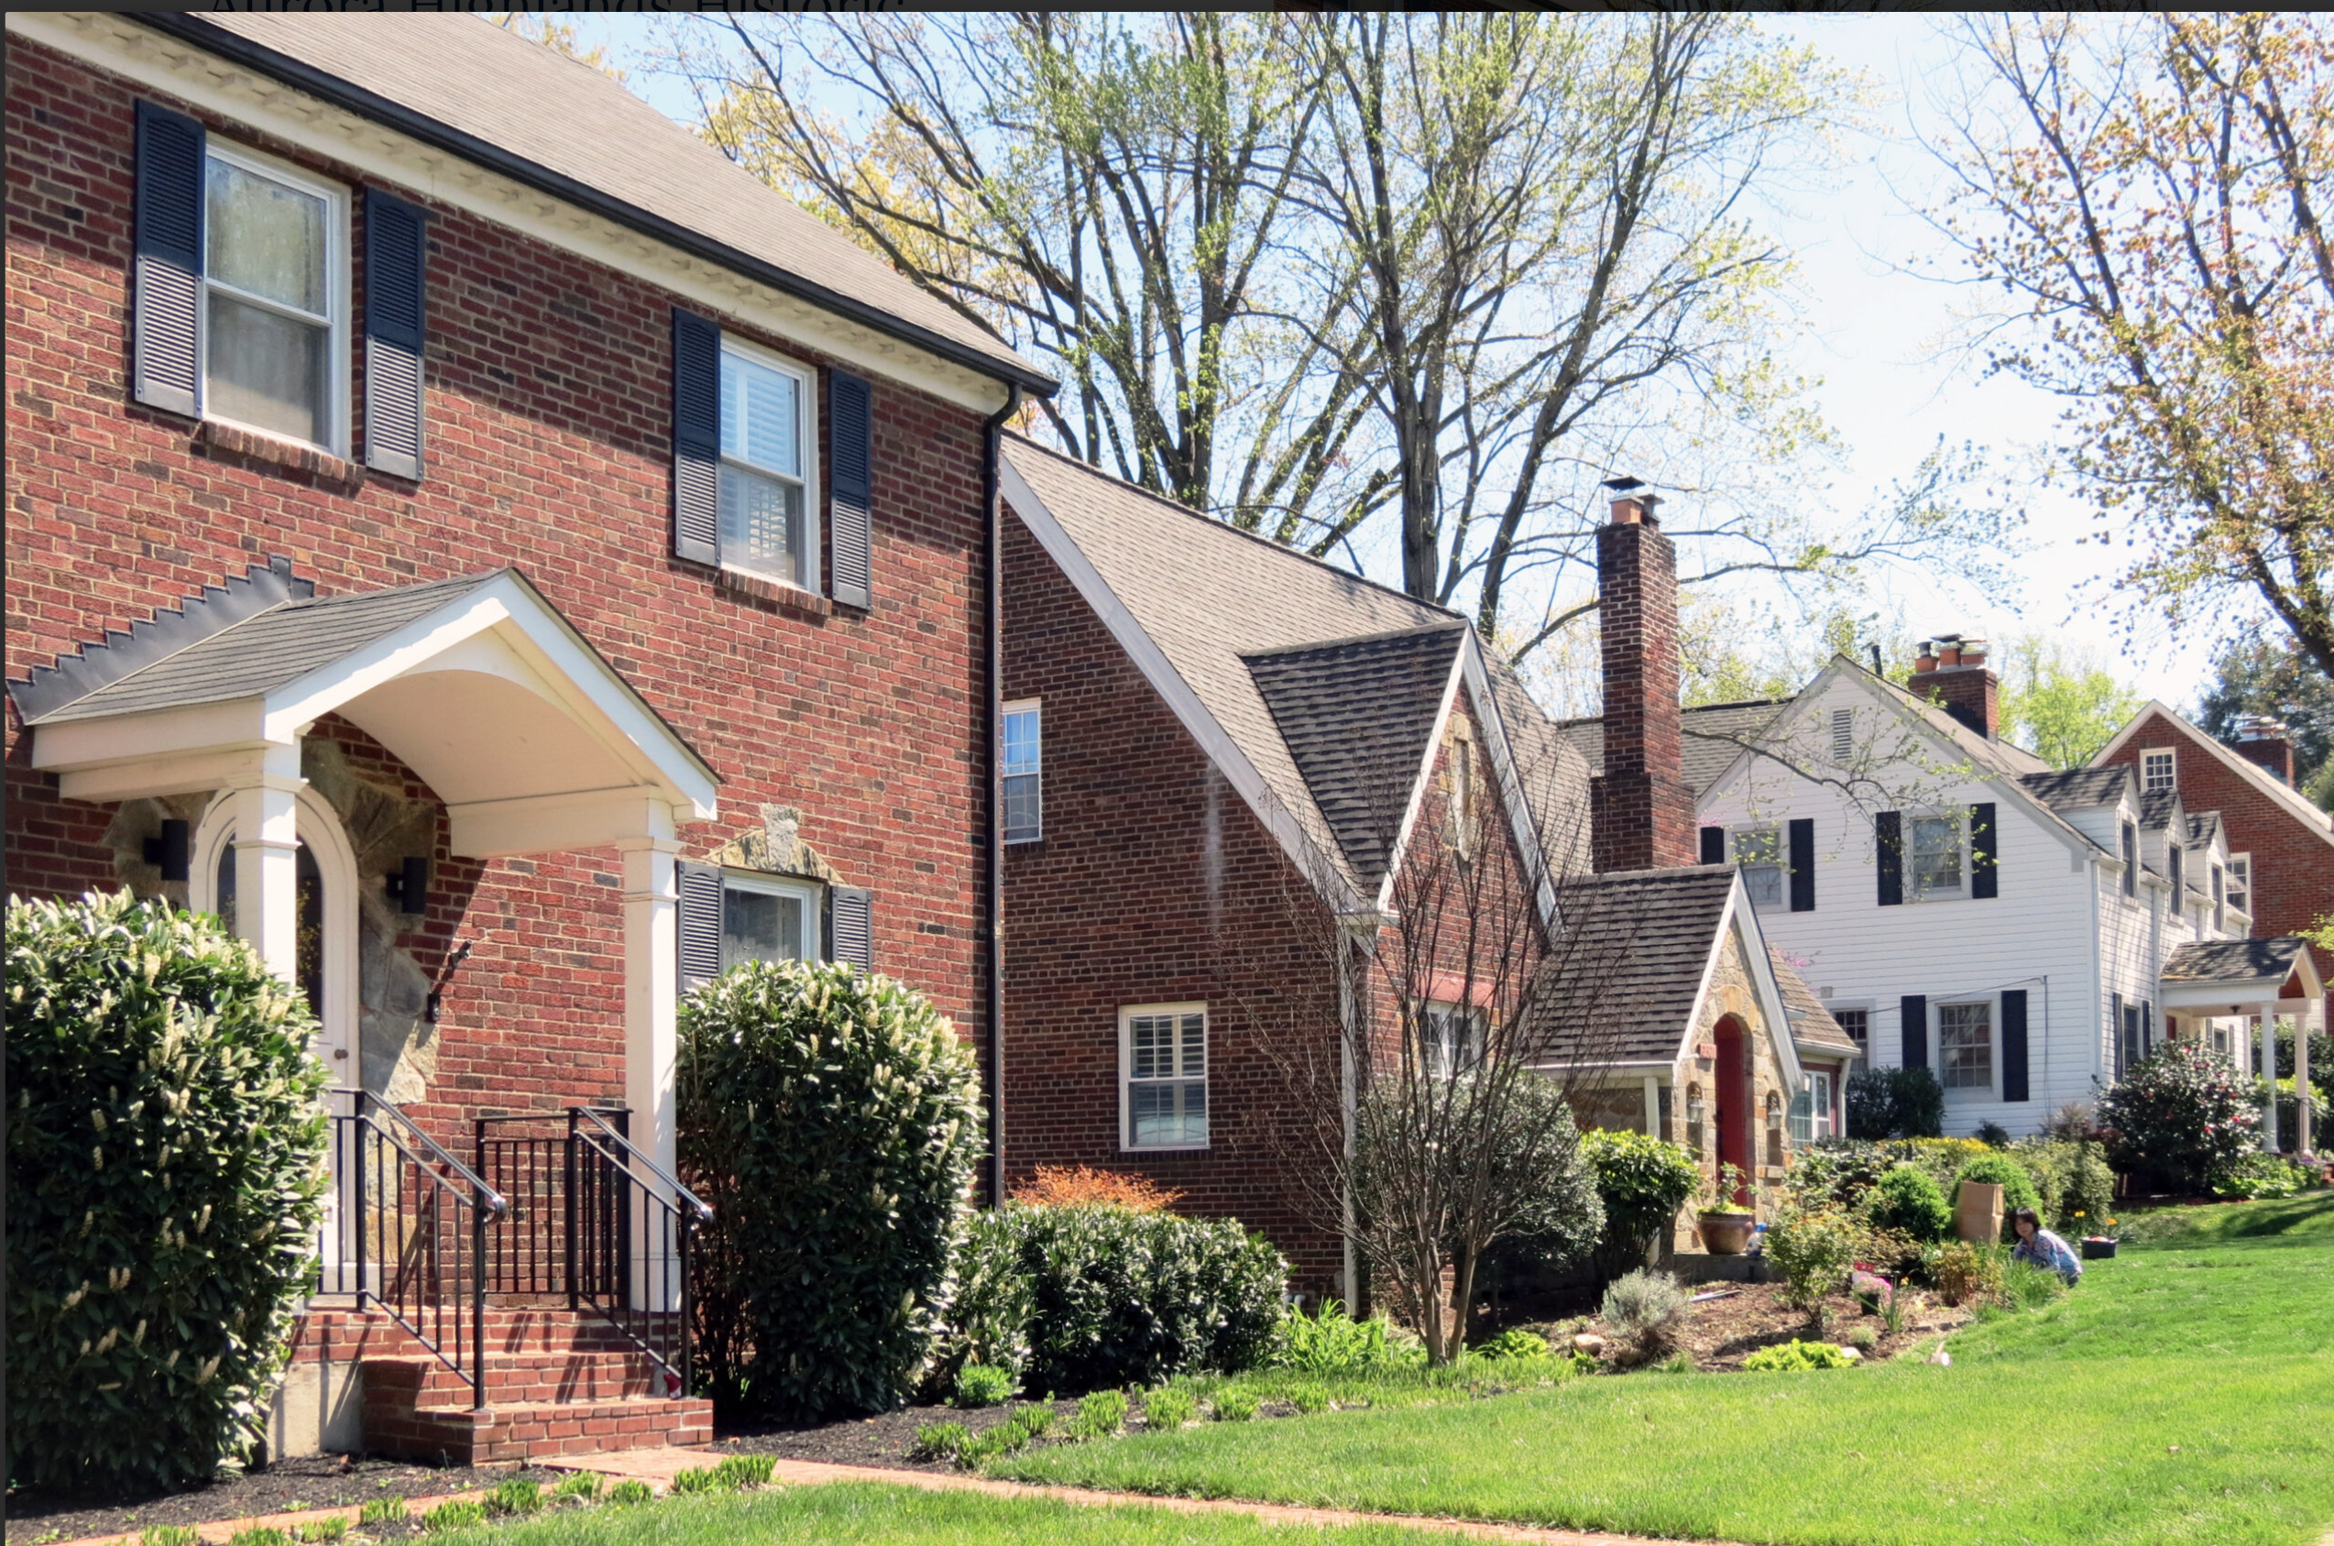
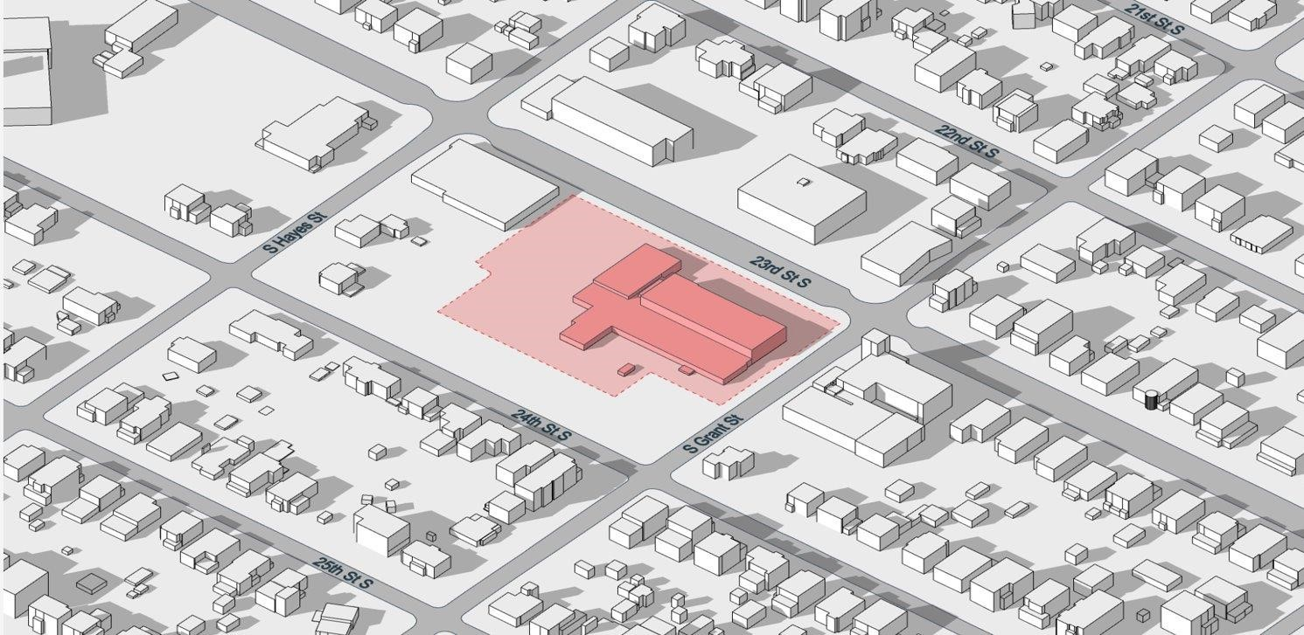
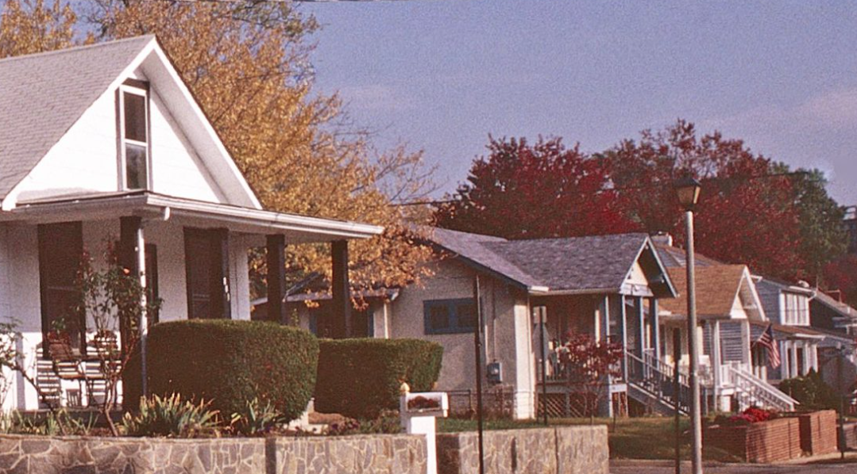
PROPOSAL IS IN THE MIDDLE OF A LOW DENSITY SINGLE FAMILY NEIGHBORHOOD – Bonus Density guidelines not met at all
per 12.3.7A, 25% bonus for affordable housing but the design must be
“appropriate for the site, project and the surrounding area”
per 15.5.9 3 (c)
“the site layout and building heights [shall] have been designed in a manner to establish effective transitions to lower density neighborhoods using site topography, landscaping, architectural façade treatments, graduated building heights, increased setbacks or other similar measures”
Nelly Custis Park
Original Nellie Custis School c. 1923

Slide 26
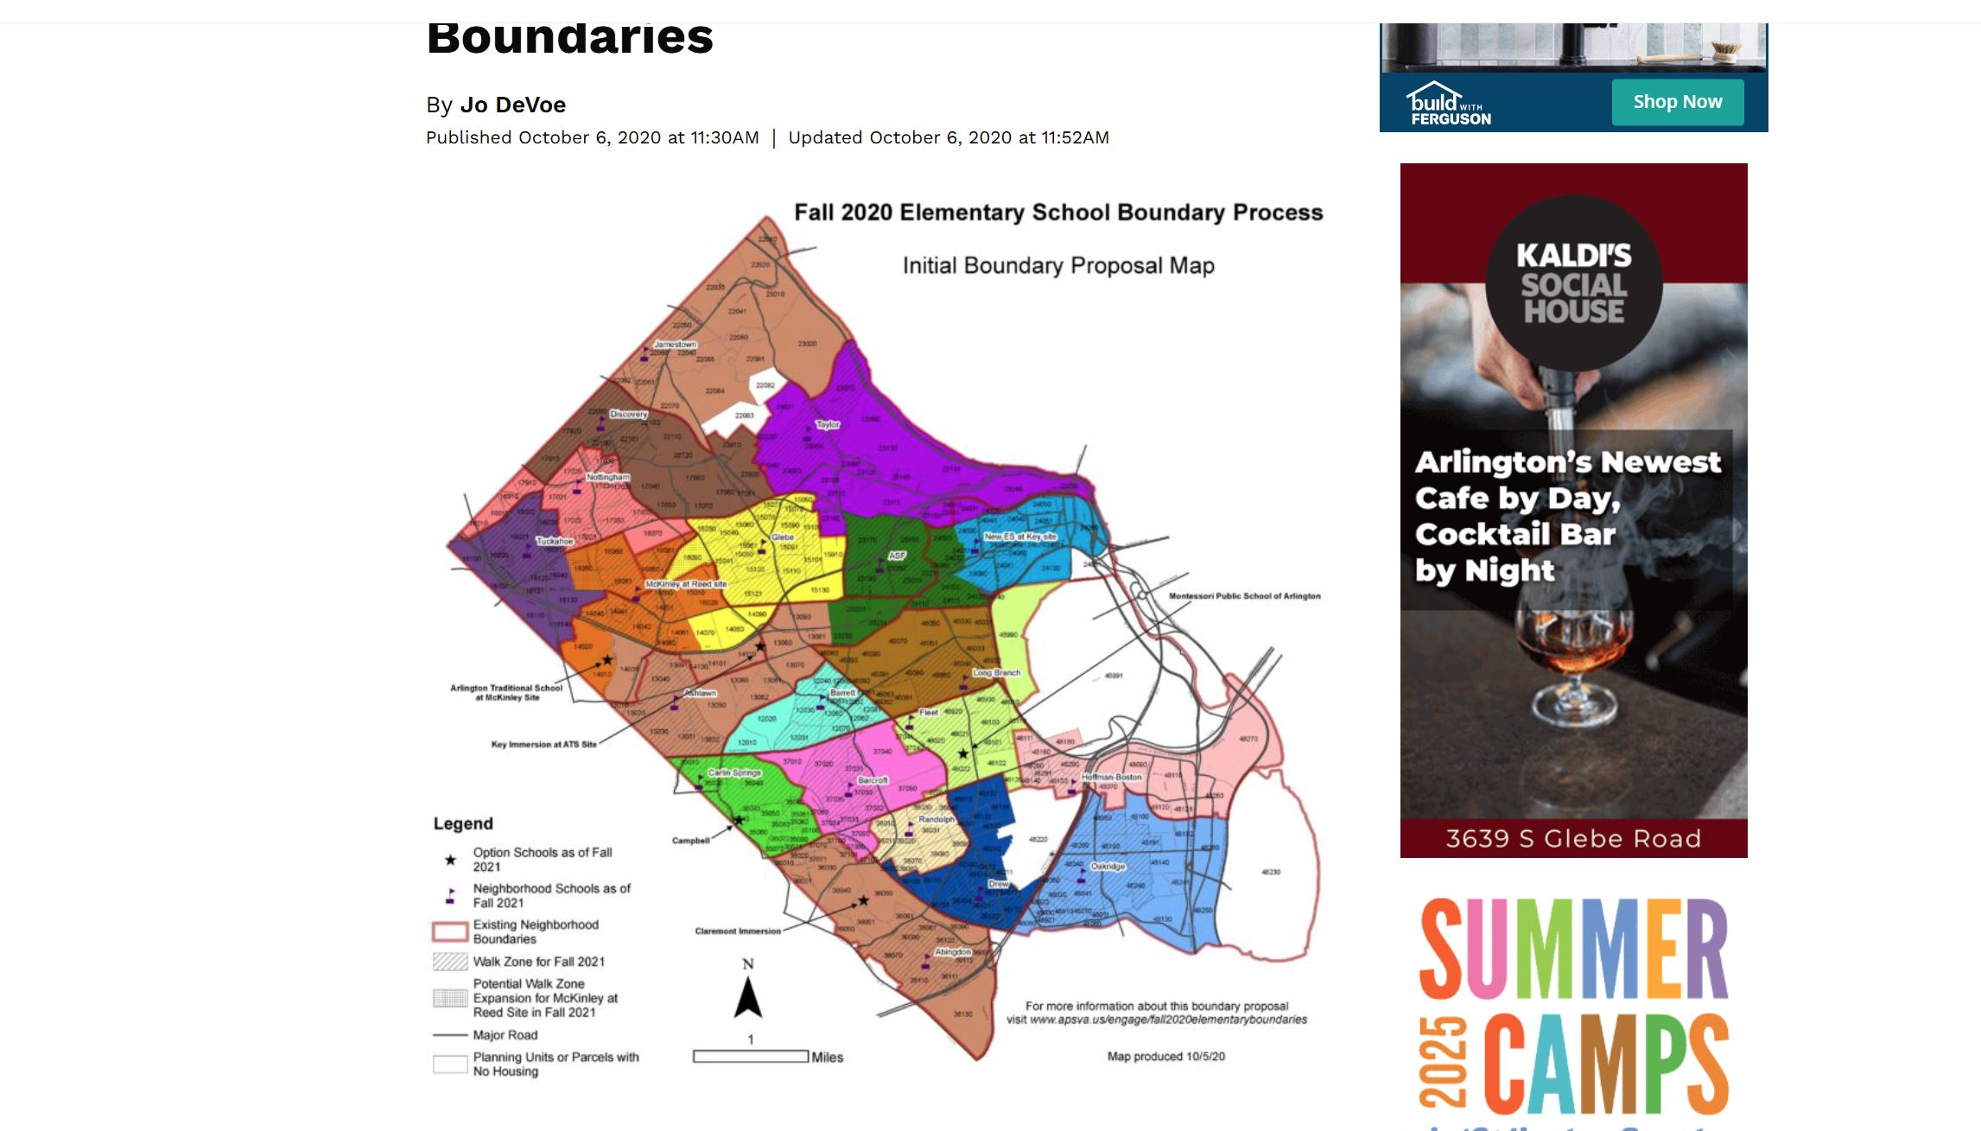
HB -88
Oak -216 (and melwood)
Drew +228
But Drew is intended for small class size
Abington + 48
Randolph +107
Fleet + 128
Long Branch +147
Barcroft - 63

