Slide 1
Melwood Site Plan Application 750 23rd Street S, Arlington
Site Plan Review Committee Presentation
November 18, 2024

Slide 2

Timeline at a Glance:
December, 2021 Melwood submitted application for Special GLUP Study to County
March, 2022 AHCA nearly unanimous vote to reject land use change sent to county with no response
April, 2024 Special GLUP Study published per Melwood requirements
May, 2024 AHCA approved comments on Special GLUP Study & alternative envelope sent to county with no response
May, 2024 County Board Acceptance of Special GLUP Study
June, 2024 AHCA vote to support Local Historic District Nomination for Nelly Custis School
June, 2024 HALRB Approval of Local Historic District Nomination (study pending)
August 2024 AHCA comments on preliminary Site Plan Application issues sent to County with no response-just acknowledgement of receipt.
October, 2024 County survey & posting of Site Plan Application
October, 2024 Insufficient notice provided for online engagement
November, 2024 AHCA comments on Final Site Plan Application sent to county
November 18, 2024 SPRC Meeting #1 (public) on site plan
December, 2024 SPRC Meeting #2 (public)
Pending:
Planning Commission
County Board
HALRB LHD Study

Slide 3
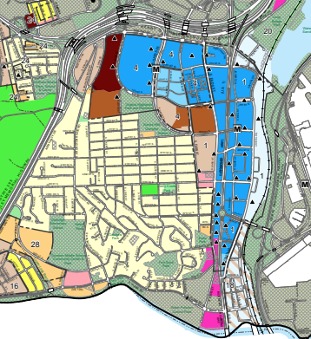
GLUP QUOTES
Page 2
If an area is shown “Public” but is not publicly owned (not crosshatched) the existing zoning of the property and surrounding land uses should determine the development potential of the site.
Very few of these locations but Nellie Custis School is one of them
COSTCO
RIVER
HOUSE
Page 6
Concentrate high-density residential, commercial and office development within designated Metro Station Areas in the Rosslyn-Ballston and Richmond Metrorail Transit Corridors. This policy encourages the use of public transit and reduces the use of motor vehicles.
Page 6
Preserve and enhance existing single-family and apartment neighborhoods. Within Metro Station Areas, land use densities are concentrated near the Metro Station, tapering down to surrounding residential areas to limit the impacts of high-density development. Throughout the County, the Arlington Neighborhoods Program and other community improvement programs help preserve and enhance older residential areas and help provide housing at a range of price levels and densities.

Slide 4
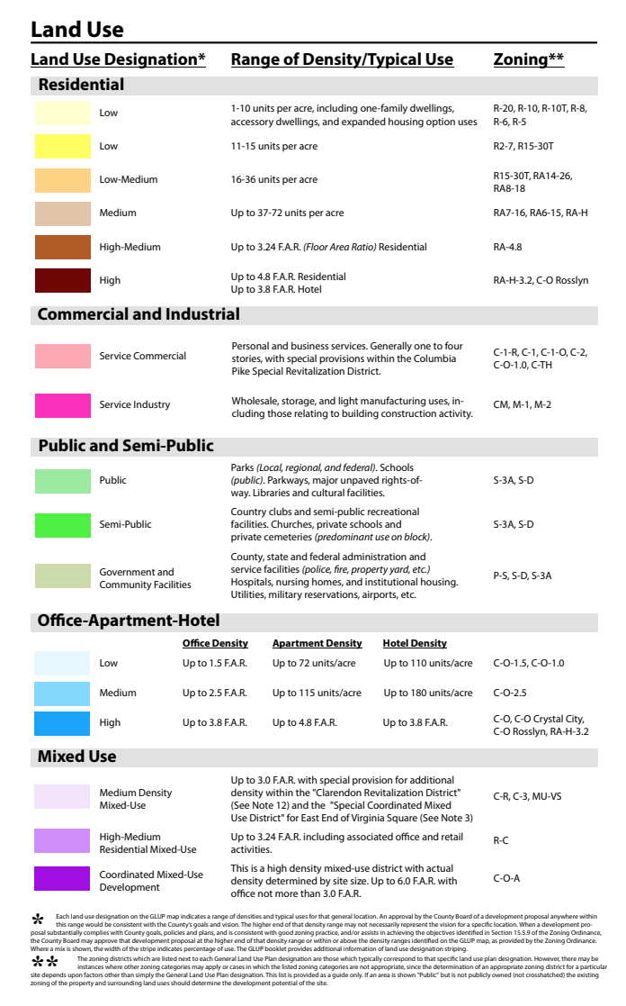
Existing Neighborhood
As Claimed in Application - but not really –aka townhouses
154K SF /1.79 Acre = 2.0 FAR
if it were part of the Sector Plan which it is not
aka Pentagon Center/ Costo Site
Proposed Envelope- if Resi Only
154K SF = 154 units possible = 86 units / acre
> 72 units / acre aka River House / Claridge
As proposed 2.0 FAR incl. office use (per arch plan)
– aka Ballston Fairfax Drive

Slide 5
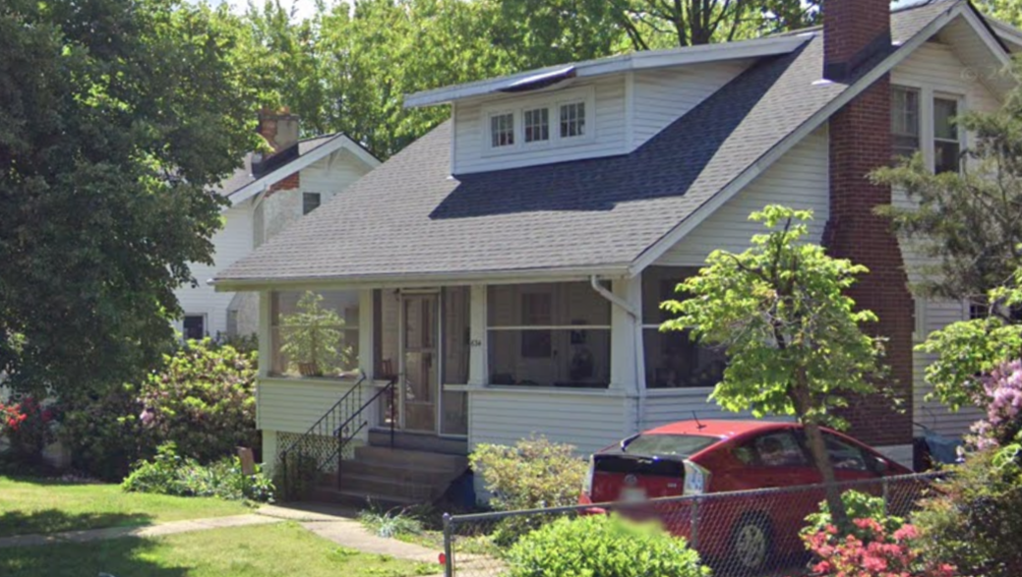
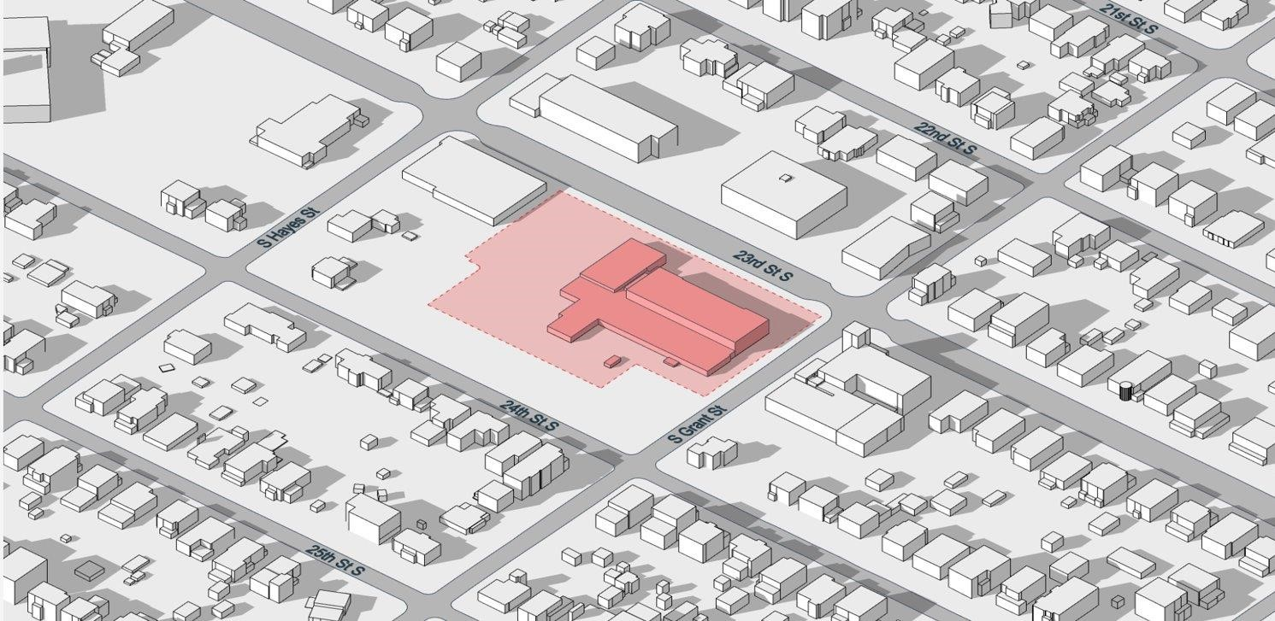
per 12.3.7A, 25% bonus for affordable housing but the design must be
“appropriate for the site, project and the surrounding area”
per 15.5.9 3 (c) up to 120 ft of height for affordable housing but
“the site layout and building heights [shall] have been designed in a manner to establish effective transitions to lower density neighborhoods using site topography, landscaping, architectural façade treatments, graduated building heights, increased setbacks or other similar measures”
Nelly Custis Park
Original Nellie Custis School c. 1923

Slide 6
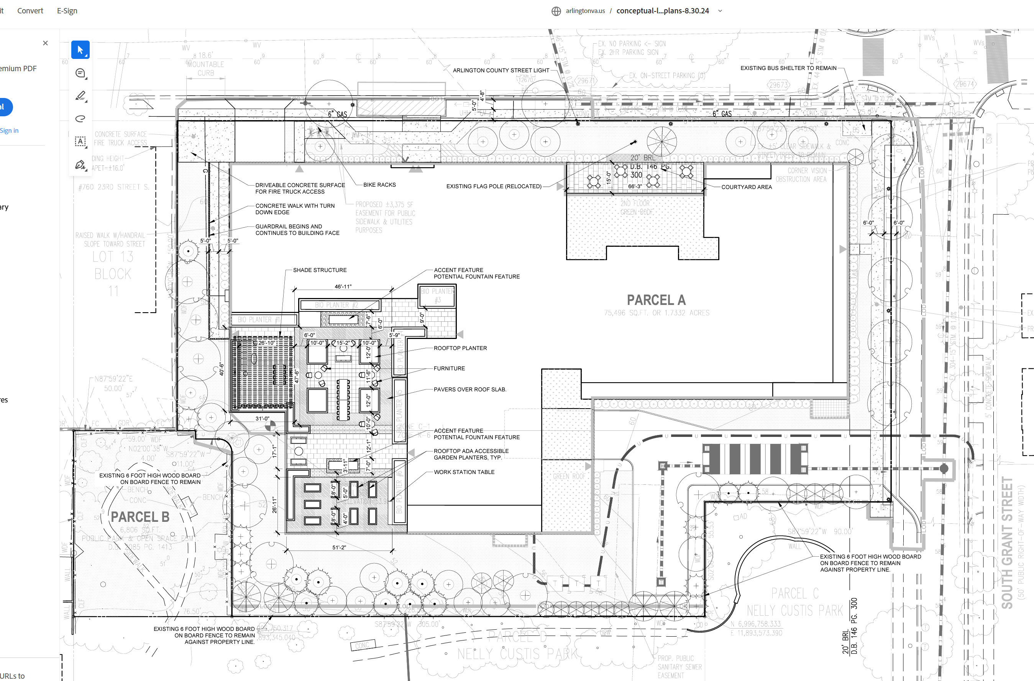
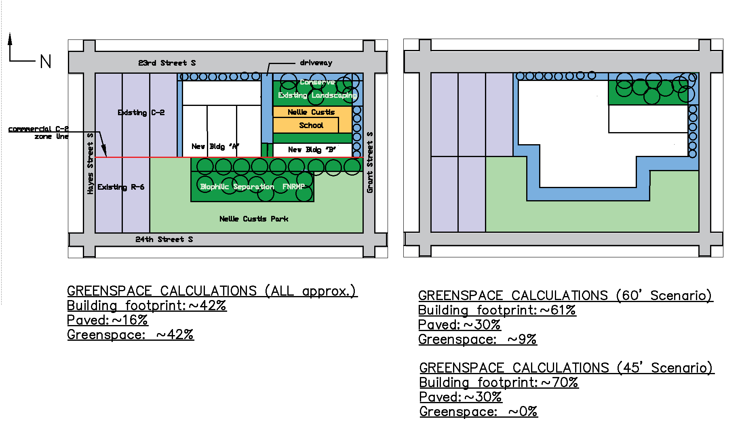
As Proposed by Melwood 154K SF
AHCA Alternative Envelope –
half the size, ~80K SF max
PARKING
LOADING & PKG
RAISED PARTY
DECK
LOADING
SIDEWALK EATS INTO PARK
TRANSFORMERS
Demo historic school
Remove 10+ mature trees
Loading dock by park, consume Grant St. parking
Min. separation from park, not enough room for tree canopy with loading + transformer field
60 -70’ + penthouse High-Med density
17% tree canopy excluding park
Inadequate parking - overflow
Unscreened raised party deck facing residential neighborhood & park
Expands sidewalk into park in NE corner
Adaptive reuse of the Nellie Custis School
Retain mature trees per GLUP Study
Parking entry and loading off of 23rd Street
Heavy separation from park – allows for tree canopy
35’ tall – actually Low- Med density
25%+ tree canopy excluding park – allows for open space, native / pollinator plantings
Adequate parking on-site / below
Solar roof potential

Slide 7
Thank You!

Slide 8
